Slide 1
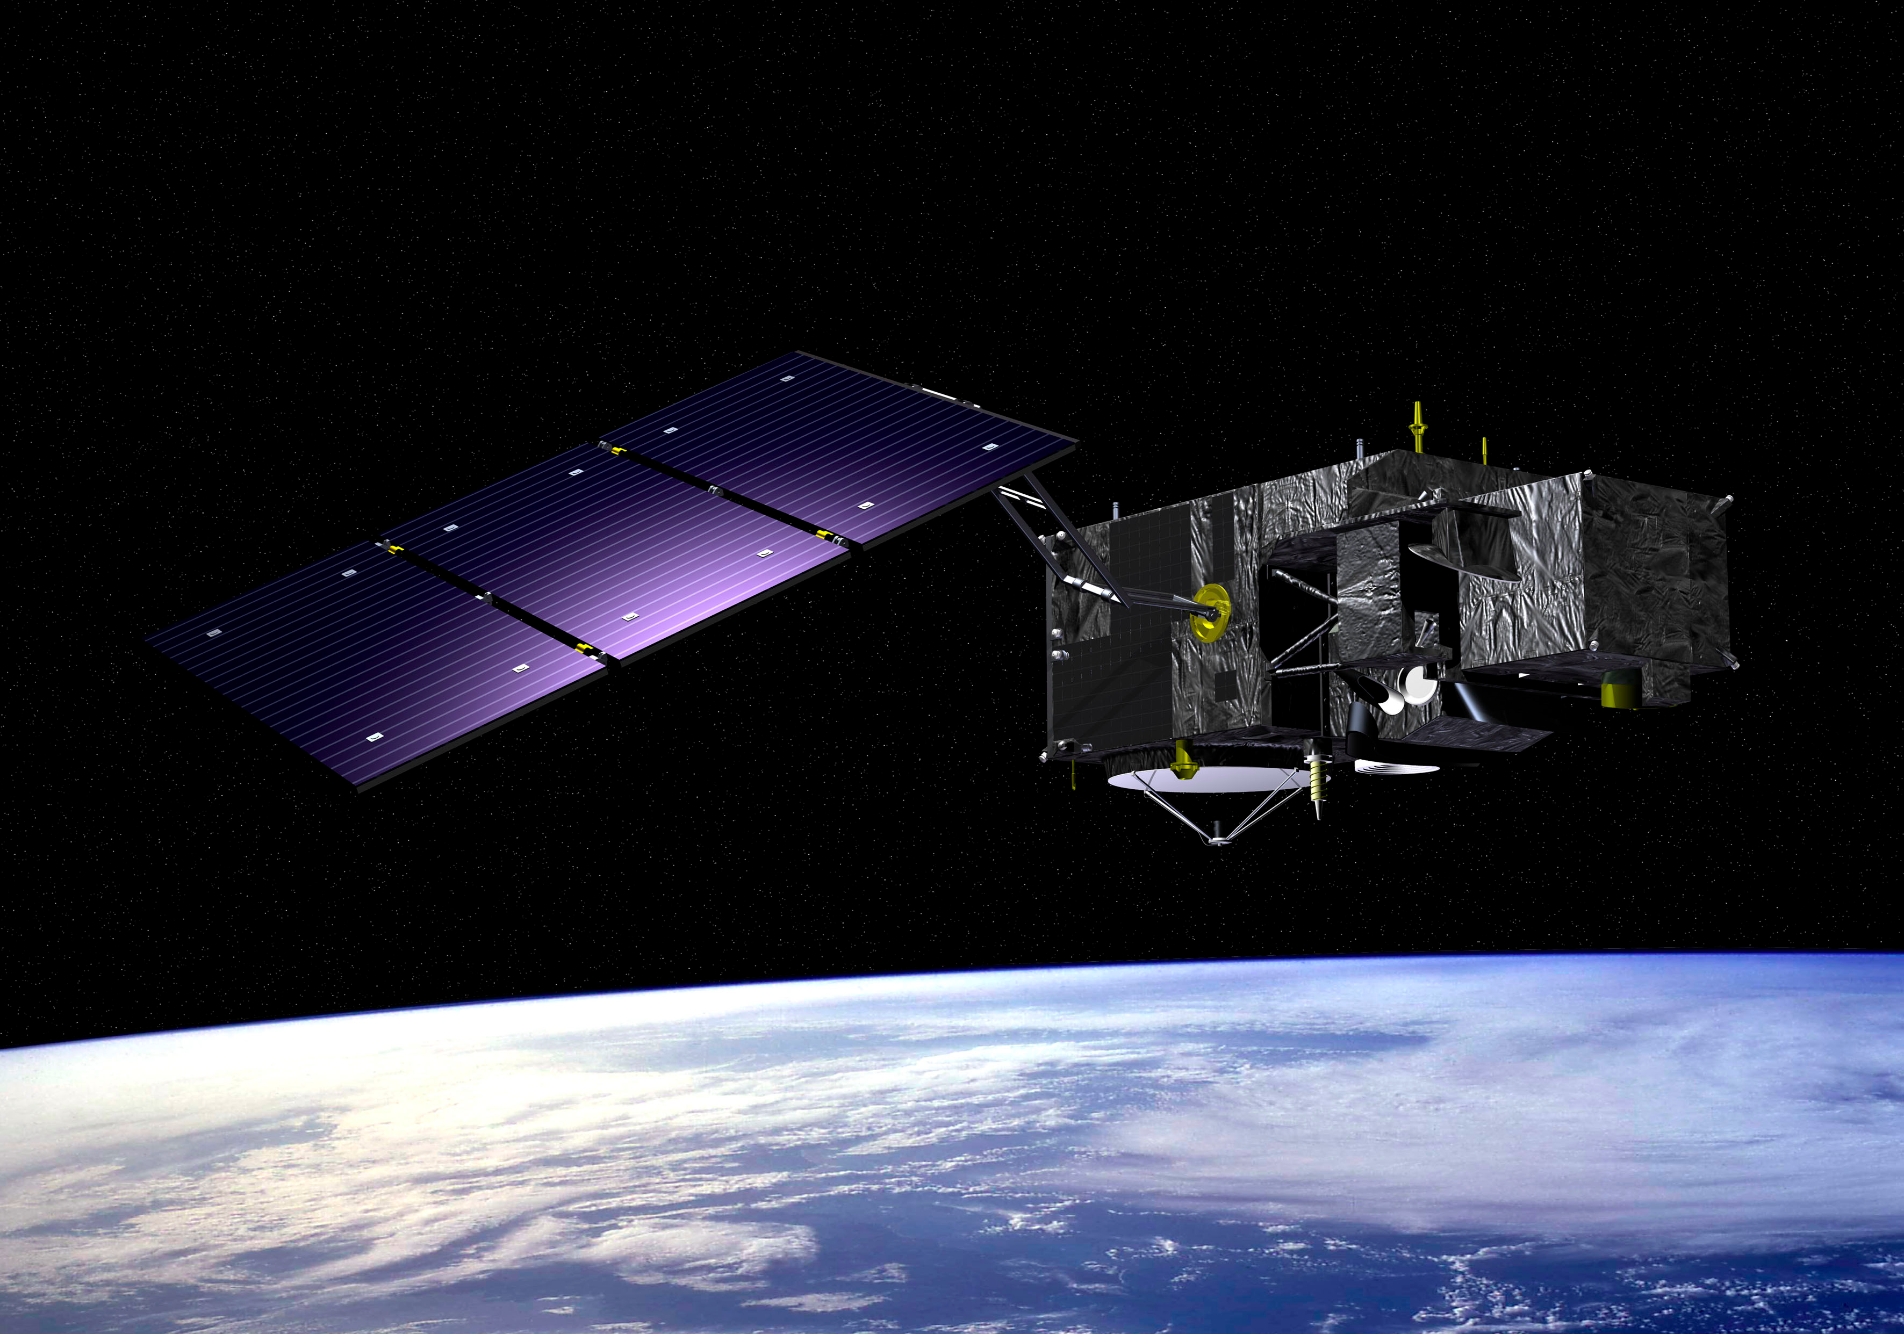
The Sentinel-3 Mission
C. Donlon, B. Berruti, J. Nieke, P. Goryl, P. Femenias, C. Mavrocordatos, H. Rebhan, B. Seitz, and U. Klein
GHRSST XIII Science Team Meeting, University of Tokyo, Japan
June 4-8th, 2012

Slide 2
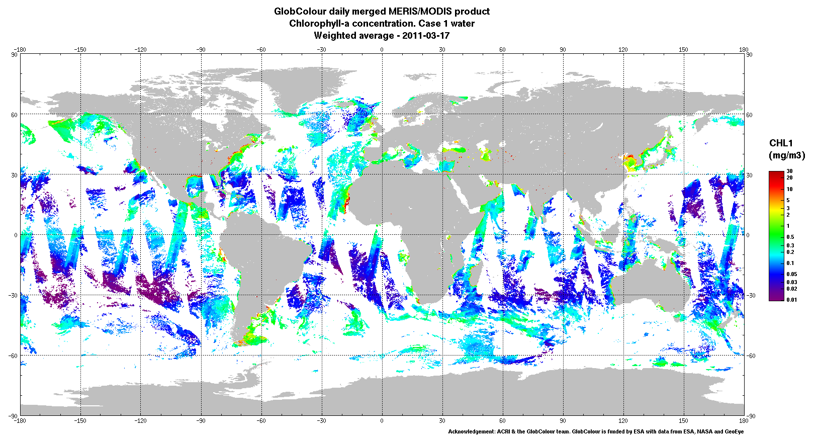
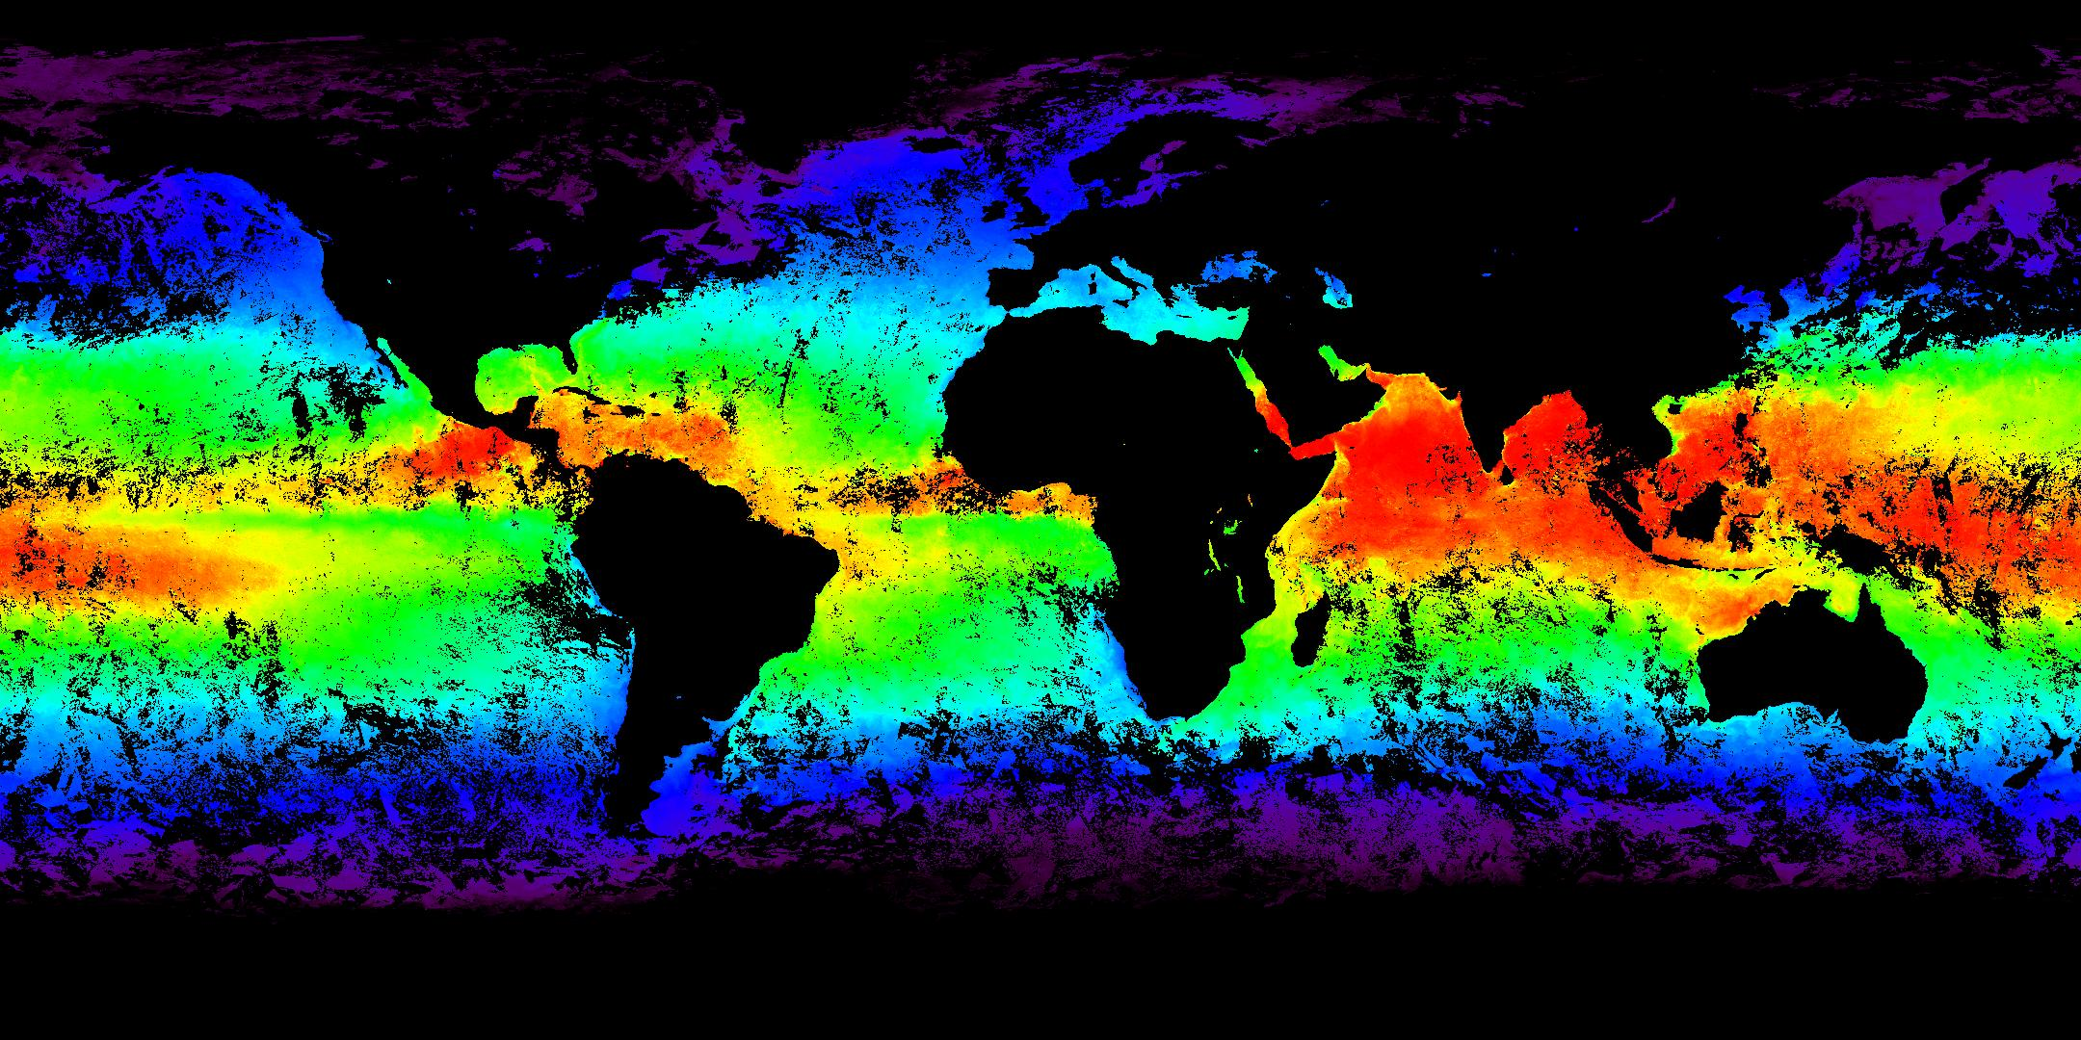
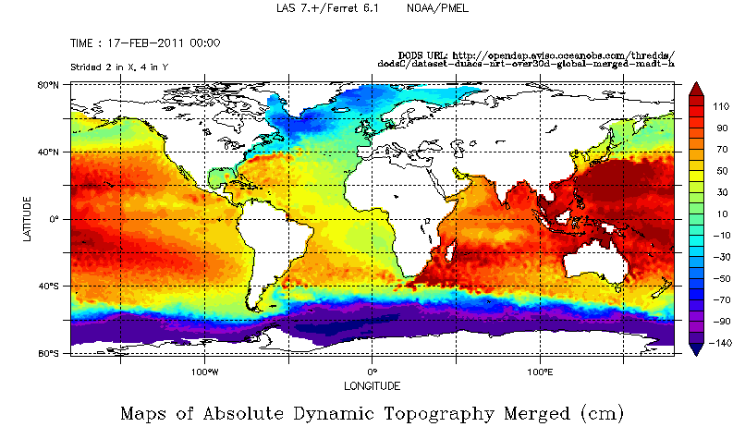
Outline
Chl-a ENVISAT MERIS, 17-18 March 2011
Background
Configuration
Payload
  Topography Mission
  Optical Mission
SLSTR
Mission Operations
Products
Cal/Val
Summary
Global SST ENVISAT AATSR monthly composite
Abs. Dynamic topography (merged mission) from AVISO, March 17 2011
Notes:
MERIS: hermes.acri.fr
AATSR:
ALT: http://www.aviso.oceanobs.com/en/data/data-access-services/live-access-server-las/index.html

Slide 3
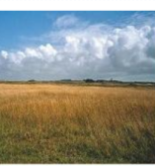





S3 Background: Objectives
Primary
Secondary
Sentinel-3 shall provide continuity of an ENVISAT type ocean measurement capability for GMES Services, including:
  Ocean, inland sea and coastal zone colour measurements to at least at the level of quality of MERIS on Envisat;
  Sea surface temperature measurements to at least at the level of quality of AATSR on Envisat;
  Sea surface topography measurements to at least at the level of quality of the Envisat altimetry system, including an along-track SAR capability of CryoSat heritage for improved measurement quality in coastal zones and over sea ice.
Continuity of medium resolution ENVISAT-type land measurement capability in Europe to determine land-surface temperature and land-surface ‘colour’ (reflectance)
L1b and L2 products derived from visible, shortwave and thermal infrared radiances and L1b/L2 topography products for use by GMES Services
Secondary: Continuity of medium resolution SPOT Vegetation P-like global products
Fire, Inland Rivers and lakes and atmospheric products
Continuity of ocean colour as good as ENVISAT MERIS or better
Continuity of SST as good as ENVISAT AATSR or better
Continuity of SSH as good as ENVISAT RA-2 or better with SAR capability derived from CryoSat-2 over coastal zones and sea ice
Continuity of land products (reflectance's, temperature) as good as ENVISAT MERIS and AATSR or better
Provide consistent quality L1b and L2 optical and topography products in a timely manner for GMES services
Continuity of SPOT VGT-P like products
Fire, River and lake height, atmospheric products…for GMES services
Notes:
MERIS Accuracy: 2-5% full range
Surface reflectance (ocean) <2 x 10 -4
Surface reflectance (Land) < 5%
Chlorophyll retrieval < 15 %
Yellow substance < 30 %
Suspended matter < 15 %
Water vapour < 20%
Cloud albedo < 2 %
Cloud optical thickness ~ 10%
Cloud top pressure ~ 40 hPa
MERIS Vegetation Index:-N/A
Water vapour < 20%
Cloud optical thickness ~ 10%
AATSR Sea surface temperature: <0.5K over 0.5 deg x 0.5 deg (lat/long) area with 80% cloud cover Land surface temperature: 0.1K (relative)
AATSR LST: <1K
RA-2 Altitude: better than 4.5cm,
RA-2 Wave height: better than 5% or 0.25m

Slide 4
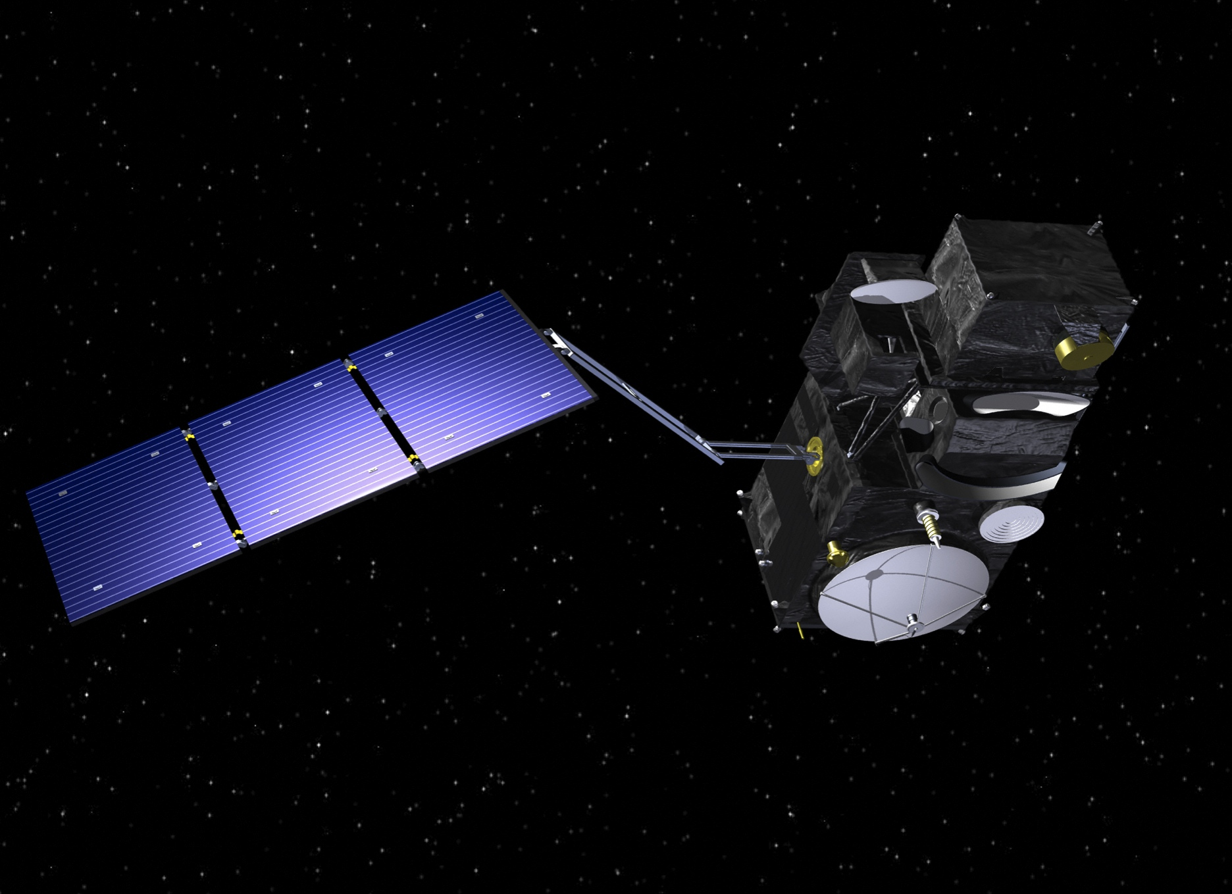

Sentinel-3: Continuity of ENVISAT Ocean Observation
Main satellite characteristics
1250 kg maximal mass
Volume in 3.89 m x 2.202 m x 2.207 m
Average power consumption of 1100 W
7.5 years lifetime (fuel for 5 add. years)
Large cold face for optical instruments
thermal control
Modular accommodation for a simplified
management of industrial interfaces
Launch S3A last ¼ 2013
Launch S3B later
Microwave
Radiometer
Ocean and Land Colour Instrument
Sea and Land Surface Temperature Radiometer
X-band Antenna
GPS
DORIS Antenna
Laser retro-reflector
Observation Data Management:
  21.25 Gb (170 Gbit) of observation data per orbit
  Space to ground data rate 2 x 280 Mbps X-Band
  1 ground contact per orbit
  3h delivery timeliness (from satellite sensing)
SAR Radar Altimeter
S-band Antenna

Slide 5
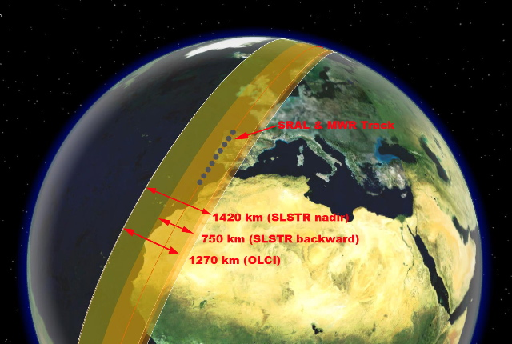
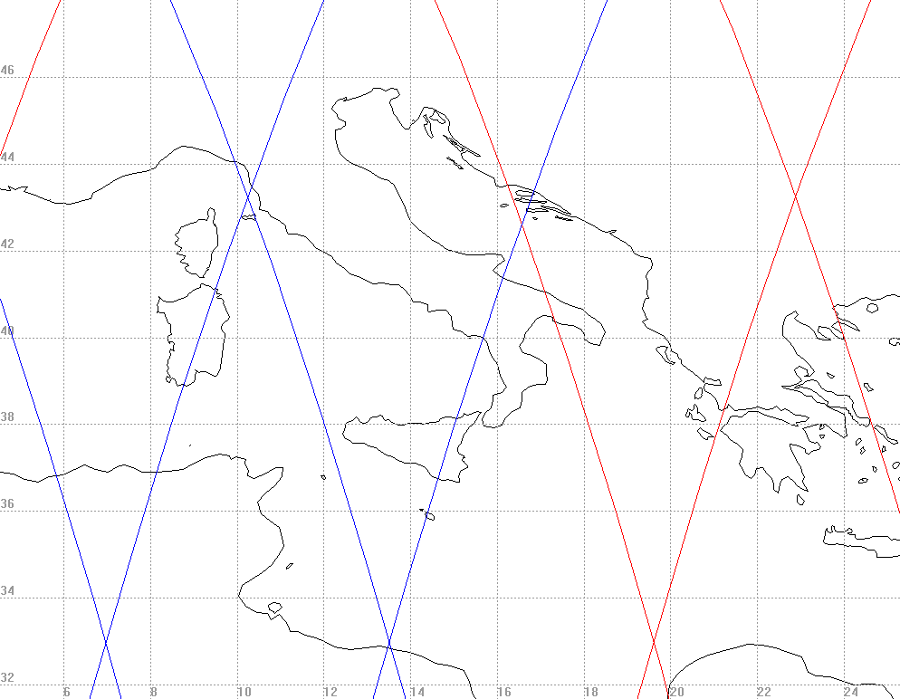
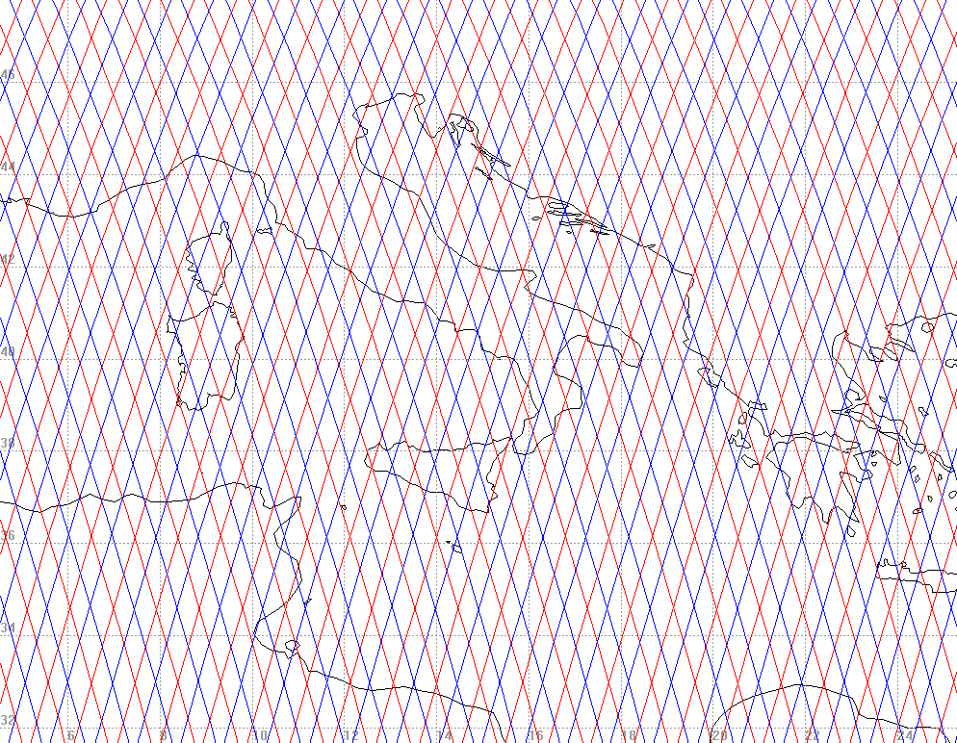
Sentinel-3: Instrument Swath and Satellite Orbit
Instrument Swath Patterns
Ground Track Patterns
S3-A
S3-B
SRAL (>2 km) and MWR (20 km) nadir track
2 days
1400 km SLSTR (nadir)
740 km SLSTR (oblique)
1270 km OLCI
1 Repeat Cycle (27 days)
Orbit type
Repeat cycle
LTDN
Average altitude
Inclination
Repeating frozen SSO
27 days (14 + 7/27 orbits/day)
10:00
815 km
98.65 deg
Notes:
Sun-synchronous frozen orbit close to 800 km
• Required for optical observations continuity
• Topography mission requirements
• Repeat cycle > 20 days,
• Optimum Topography mission spatial sampling
• Minimization of aliasing
• Ocean Colour mission requirements
• 2-day global coverage with 2 satellites, 4 days with one
Implies a sub-cycle of 4 days
• Local time of observation shall be > 10 h to avoid morning haze
• Sea Surface Temperature mission requirements
• Local time at node shall be < 11 h to avoid skin effects
The second S3 satellite shall be positioned ensuring the best compromise between:
The minimum OC mission Revisit Time (the most stringent RT requirement due to Sun-glint constraint)
The most regular Topography mission spatial sampling (smallest 27-days mesh cell size)
Phasing the two satellites on the same orbit with an anomaly difference of 180° fulfils both objectives.

Slide 6
Sentinel-3 Optical Revisit time and coverage
Optical missions:
Short Revisit times for optical payload, even with 1 single satellite
 |  | Revisit at Equator | Revisit for latitude > 30° | Requ.
Ocean Colour (Sun-glint free, day only) | 1 Satellite | < 3.8 days | < 2.8 days | < 2 days
 | 2 Satellites | < 1.9 days | < 1.4 days
Land reflectance(day only) | 1 Satellite | < 2.2 days | < 1.8 days | < 2 days
 | 2 Satellites | < 1.1 day | < 0.9 day
SLSTR dual view (day and night) | 1 Satellite | < 1.9 days | < 1.5 days | < 4 days
 | 2 Satellites | < 0.9 day | < 0.8 day
Data delivery timeliness:
Near-Real Time (< 3 hr) availability of the L2 products
Slow Time Critical (STC) (1 to 2 days) delivery of higher quality products for assimilation in models (e.g. SSH, SST)

Slide 7
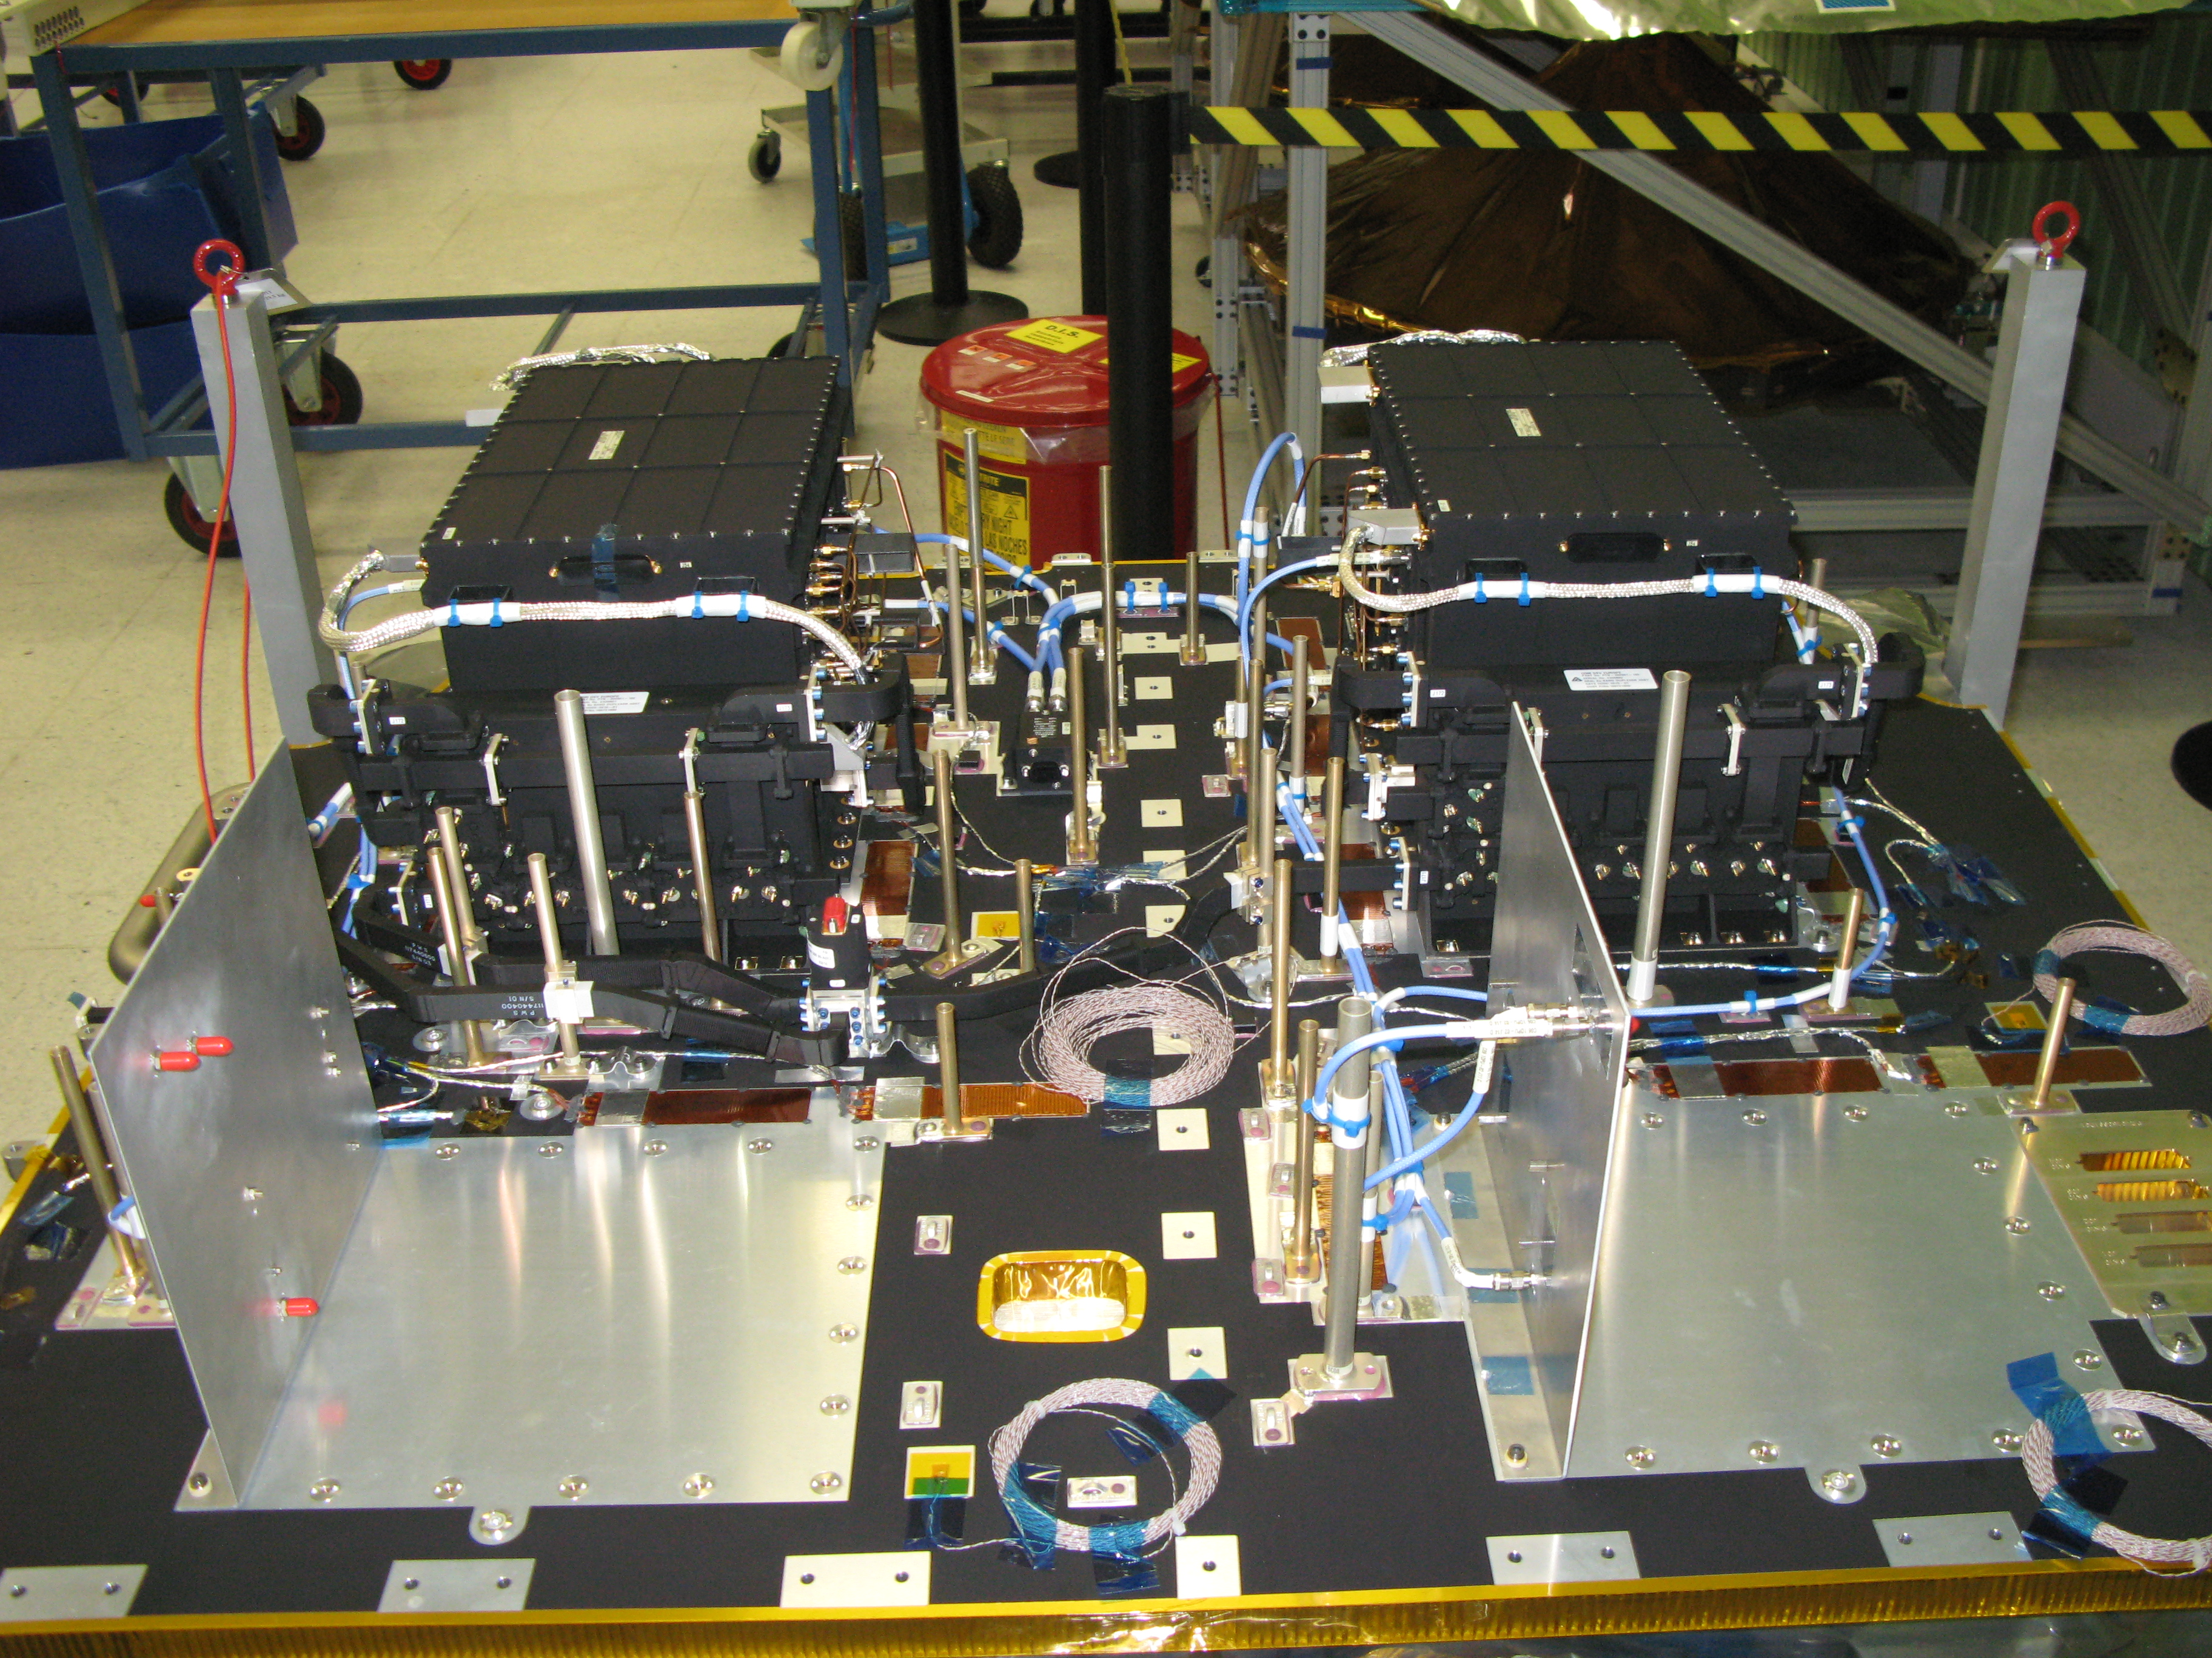
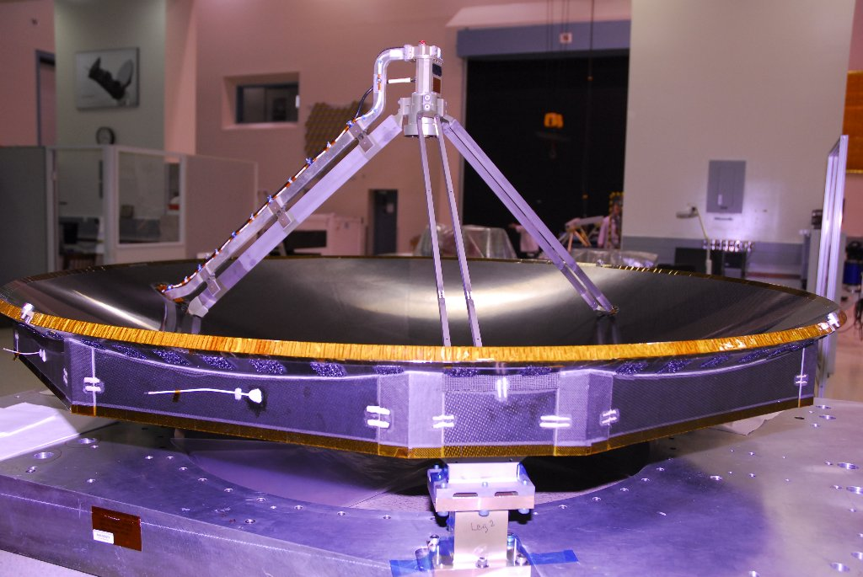
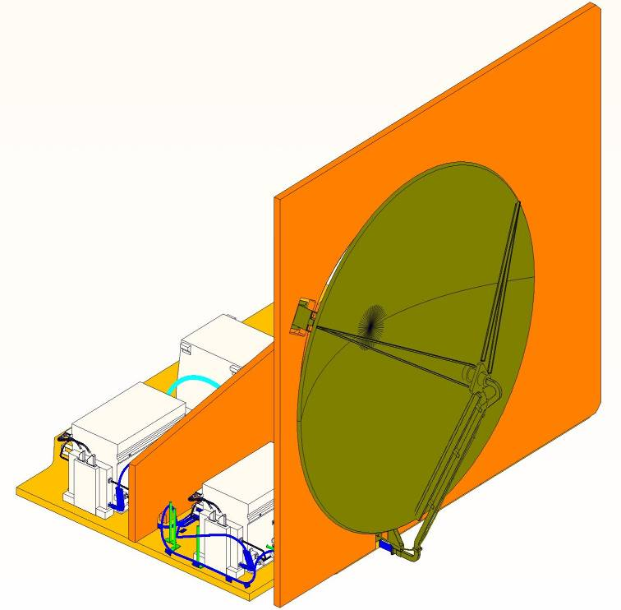
S3 SAR RADAR Altimeter and Microwave Radiometer
Dual frequency Ku/C band Radar Altimeter
  CryoSat and Jason heritage
  High horizontal resolution (~300m in SAR mode)
SRAL Radar features:
  Ku-Band (13.575 GHz) : main frequency
  C-Band (5.41 GHz) : ionosphere corrections
  Fully redundant electronics
Measurement modes:
2 radar modes:
  Low Resolution Mode (LRM) and
  Nadir high res. SAR mode
2 tracking modes:
  Closed-loop (traditional) and
  Open-loop tracking modes over rough surfaces
Any radar mode can be combined to any tracking mode
Objective: To retrieve orbit altitude information with an end-to-end accuracy of 3 cm (Ocean)
Supported by a 2 channel Microwave Radiometer (23.8 and 36.5 GHz)

Slide 8
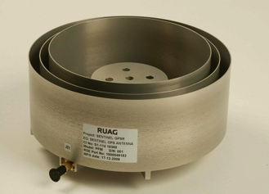
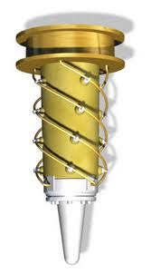
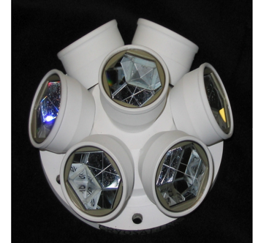
S3: Precise Orbit Determination (POD)
  8 channel GPS receiver (~3m NRT, 2-3cm on ground)
    Satellite Navigation – AOCS (on-board – permanent function)
    Datation of scientific telemetry (on-board – permanent function)
    Control of SRAL open-loop tracking (on-board – commanded function)
    POD (on ground)
    USO frequency monitoring (on-ground)
  DORIS Navigation receiver (~1 cm)
    Provide USO frequency to SRAL (on-board – permanent function)
    Control of SRAL open-loop tracking (on-board – commanded function)
    POD (on ground)
    USO frequency monitoring (on-ground)
  Laser Retro-Reflector (<2 cm)
    Contribution to POD, validation of POD solution
  POD radial accuracy requirements (rms)
    Near Real Time (NRT < 3h): 10 cm (8 cm goal)
    Short Time Critical (STC < 48h): 4 cm (3 cm goal)
    Non Time Critical (NTC < 1 month): 3 cm (2 cm goal)

Slide 9
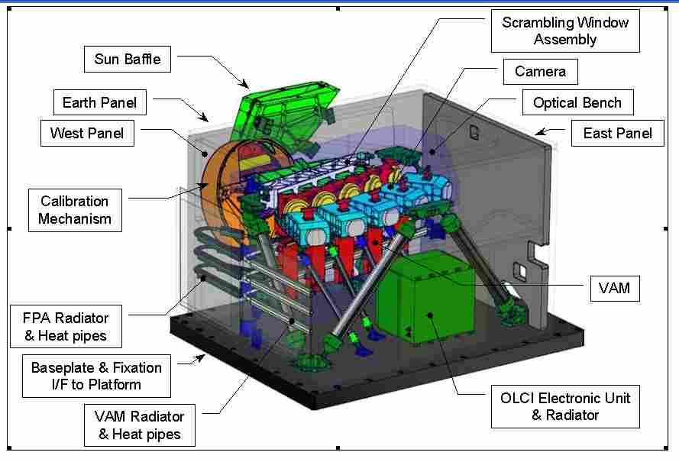
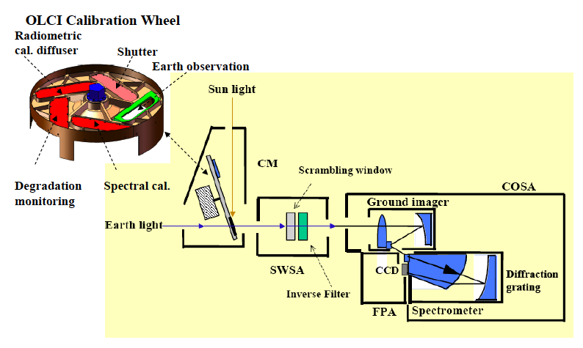
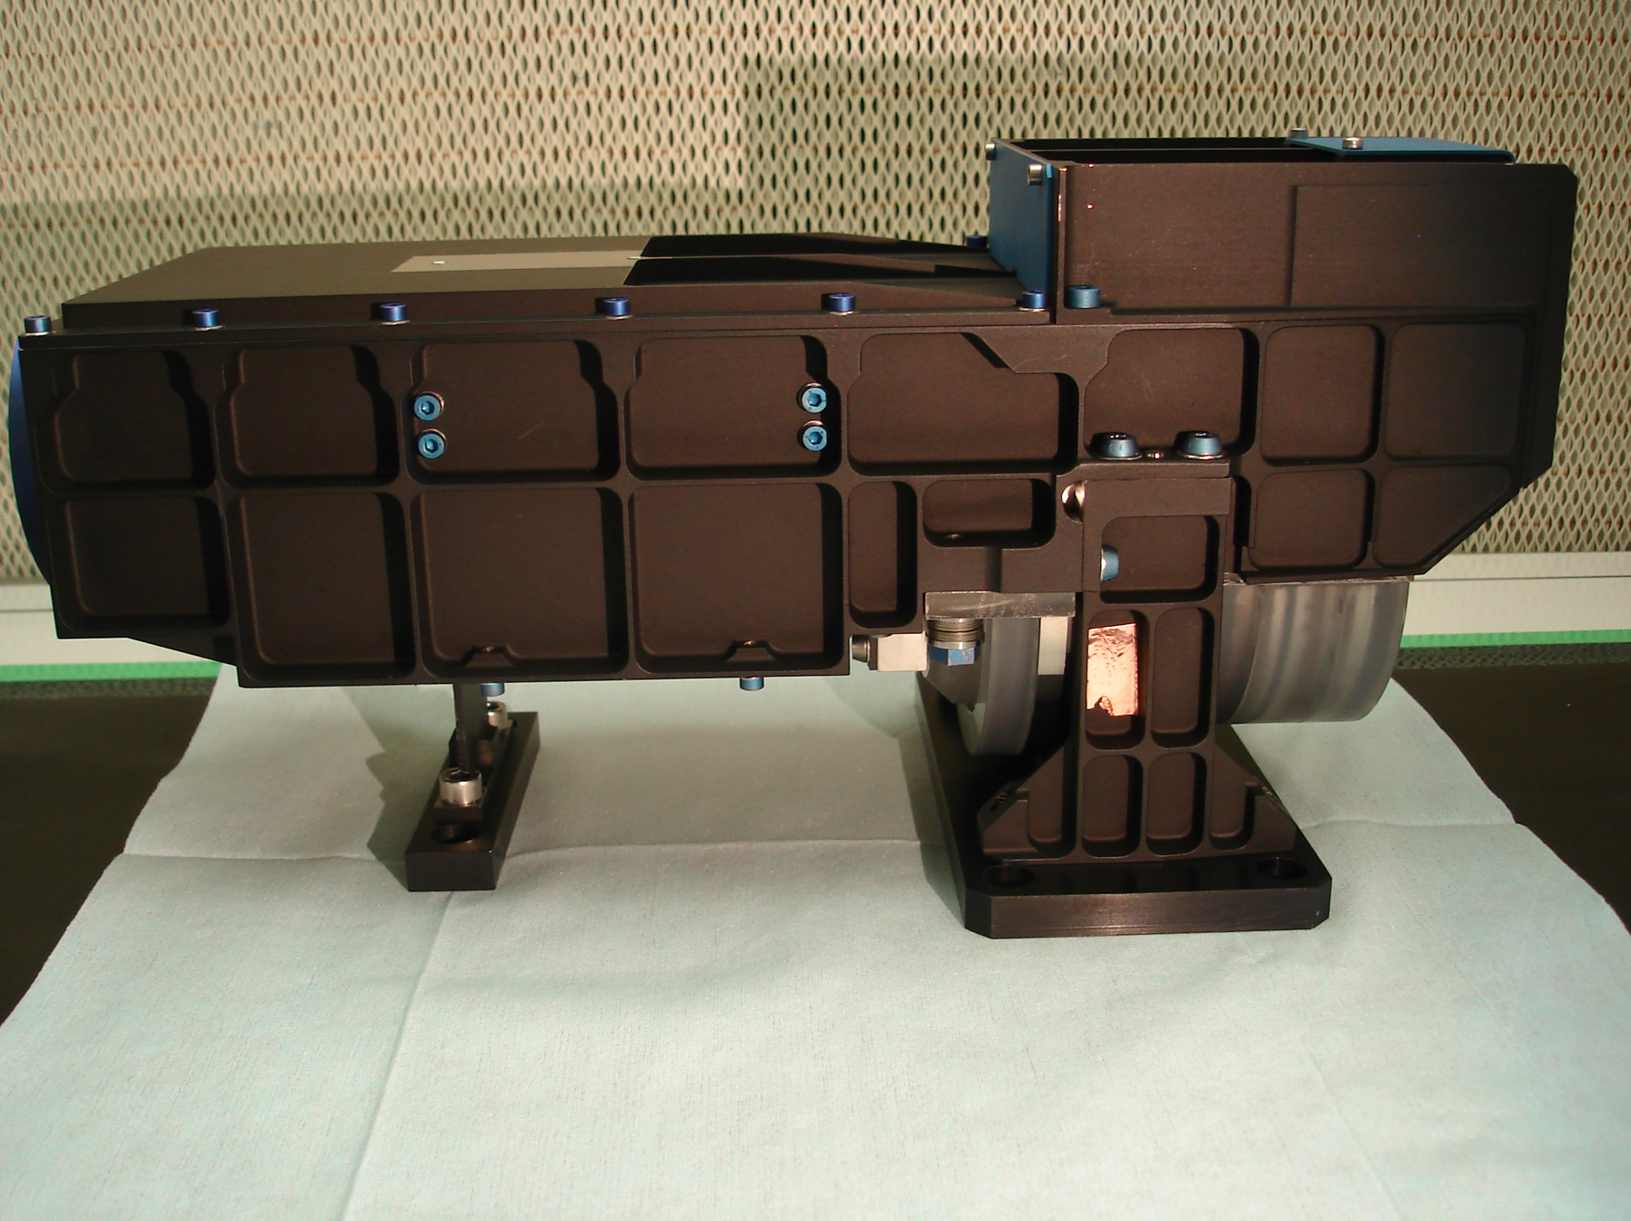
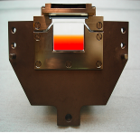
S3 OLCI: Technical details
Basic configuration similar to MERIS:
5 Camera Optical Sub Assemblies (COSA),
5 Focal Plane Assemblies (FPA),
5 Video Acquisition Modules (VAM),
1 Scrambling Window Assembly (SWA),
1 OLCI Electronic Unit (OEU) managing all the instrument functions,
1 calibration assembly allowing a radiometric and spectral calibration
Optical layout
Notes:
One of the five OLCI Cameras (here an engineering model), the insert showing the charge-coupled device (CCD)
9

Slide 10
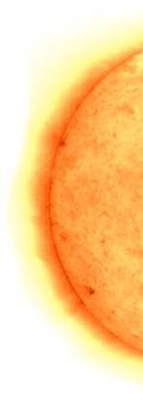
Sentinel-3 OLCI
Basic Geometry
5 cameras
Calibration
Assembly
~68.5° FoV
Across-
track-tilt
~09:00 LST
10:00 LST
~10:30 LST
1270 km

Slide 11
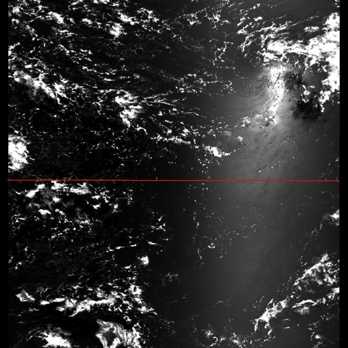
Transect showing MERIS sunglint, MERIS band 9 (708 nm) Hawaii 20030705
200
180
160
Approximate position of OLCI cameras
140
120
100
radiance_9 [mW/(m^2*sr*nm)]
80
60
40
20
0
-160
-158
-156
-154
-152
-150
-148
-146
longitude (deg)
(R. Doerffer)

Slide 12
OLCI: Ocean and Land Colour Instrument - comparison to MERIS
Pushbroom Imaging Spectrometer (VIS-NIR) – similar to MERIS
MERIS Bands | λ center | Width
Yellow substanace/detrital pigments | 412.5 | 10
Chl.. Abs. Max | 442.5 | 10
Chl & other pigments | 490 | 10
Susp. Sediments, red tide | 510 | 10
Chl. Abs. Min | 560 | 10
Suspended sediment | 620 | 10
Chl. Abs, Chl. fluorescence | 665 | 10
Chl. fluorescence peak | 681.25 | 7.5
Chl. fluorescence ref., Atm. Corr. | 708.75 | 10
Vegetation, clouds | 753.75 | 7.5
O₂ R-branch abs. | 761.25 | 2.5
O₂ P-branch abs. | 778.75 | 15
Atm corr | 865 | 20
Vegetation, H₂O vap. Ref. | 885 | 10
H₂O vap., Land | 900 | 10
Key Improvements:
  More spectral bands (from 15 to 21): 400-1020 nm
  Broader swath: 1270 km
  Reduced sun glint by camera tilt in west direction (12.20°)
  Absolute (relative) accuracy of 2% ( relative 0.5%)
  Polarisation sensitivity < 1%
  Full res. 300m acquired systematically for land & ocean
  Reduced res. 1200m binned on ground (L1b)
  Improved characterization, e.g. straylight, camera boundary characterization
  Ocean coverage < 4 days, (< 2 days, 2 satellites)
  Timeliness: 3 hours NRT Level 2 product
  100% overlap with SLSTR
  => Improved L2 products e.g., Cla, Transparency, TSM, Turbidity, PFTs, HAB, NDVI, MGVI, MTCI, faPAR, LAI
New OLCI bands | λ center | Width
Aerosol, in-water property | 400 | 15
Fluorescence retrieval | 673.75 | 7.5
Atmospheric parameter | 764.375 | 3.75
Cloud top pressure | 767.5 | 2.5
Atmos./aerosol correction | 940 | 20
Atmos./aerosol correction | 1020 | 40

Slide 13
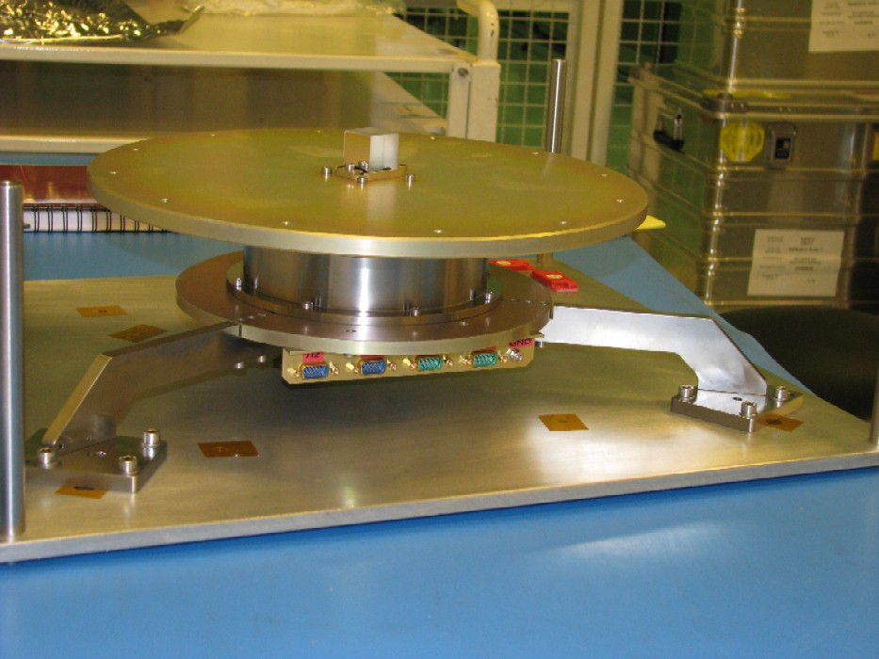
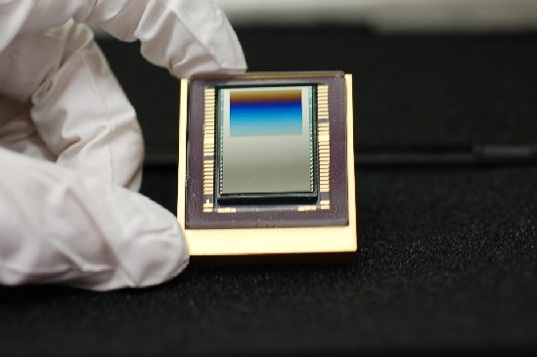
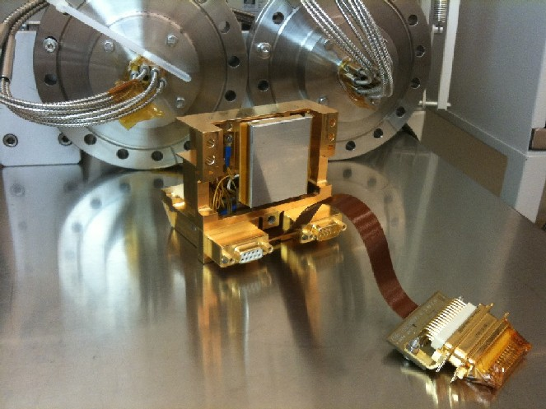
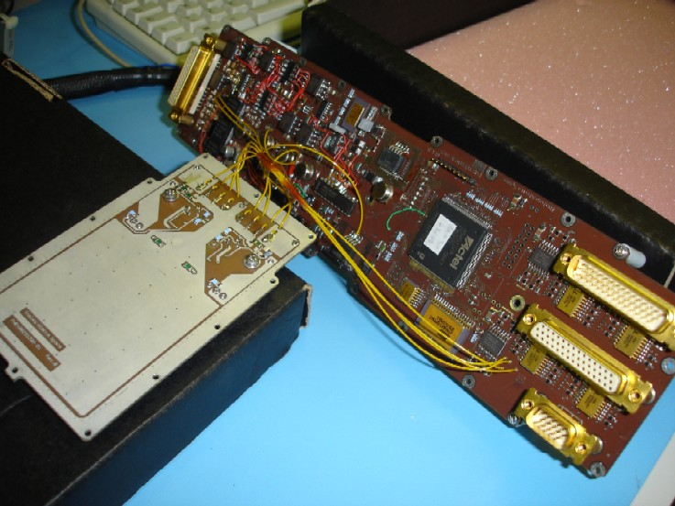
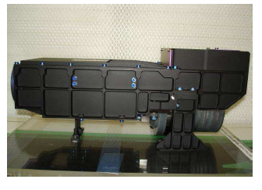
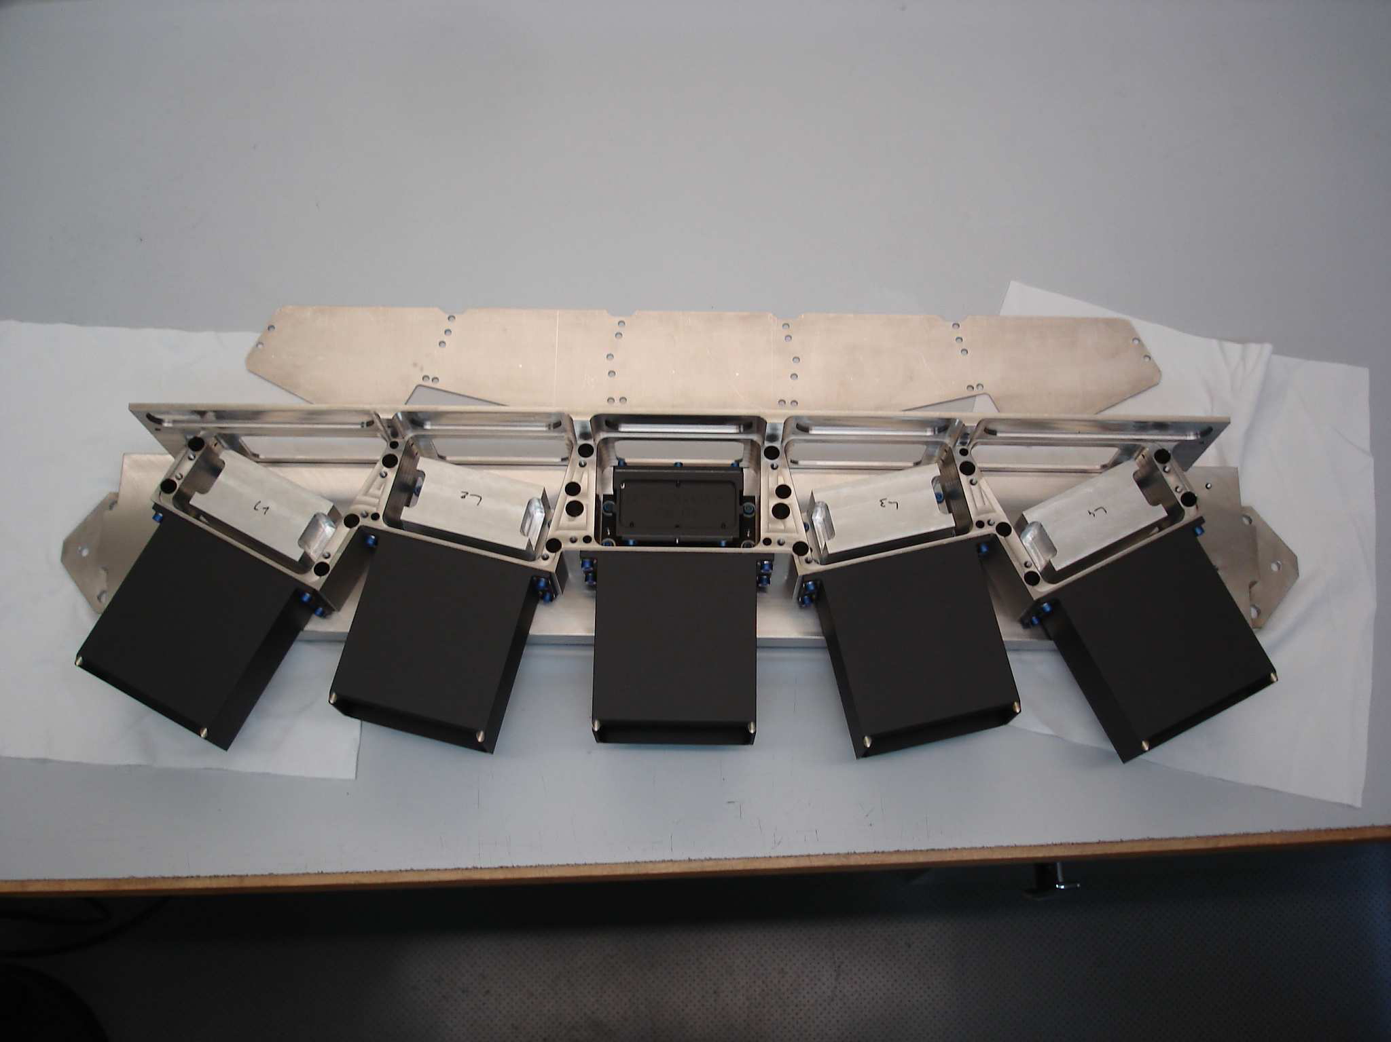
OLCI development status
(May-2012)
CM
Calibration HW
BRDF bench
5xSWU
CCD
FPA
VAM
COSA
  CDR was finally declared successful in Nov-2011 - testing of EM and FM HW started.
  Camera Optical Sub-Assembly (COSA): 5 x FM Cameras successfully delivered
  Calibration Mechanism (CM): FM under testing, FM S3A/B diffusers characterisation on-going
  Scrambling Window (SWU): SWU GSE delivered, FM testing is on going.
  Charge Couple Devices (CCDs): all CCDs for S3A and S3B delivered
  Video Acquisition Module (VAM) and Focal Plane Assembly (FPA): EM delivered and FPA PFM and VAM PFM testing is on-going
  OLCI Electronics Unit (OEU): EM testing started
  OLCI structure: PFM manufacturing on-going

Slide 14
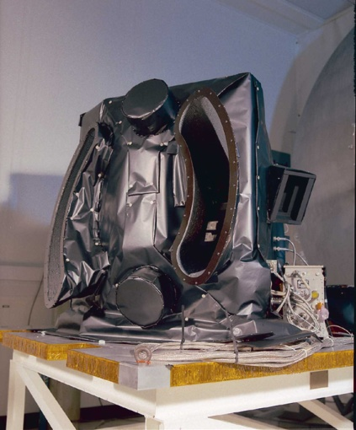
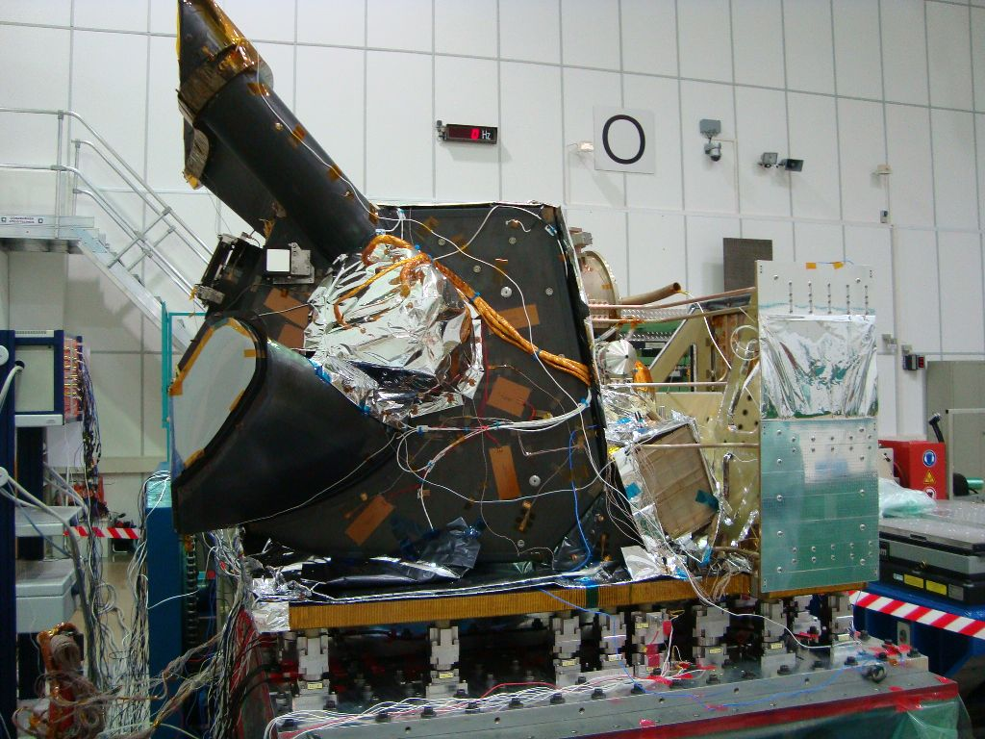
Sea and Land Surface Temperature Radiometer SLSTR
SLSTR has been designed to measure SST and Land Surface Temperature with an equivalent baseline performance to ENVISAT A/ATSR (ATSR-3)
We hoped to provide seamless continuity with AATSR…
Designed to extend and improve the (A)ATSR series but maintains fundamental concepts and elements of the original
SLSTR == ATSR-4…
(TBC)

Slide 15
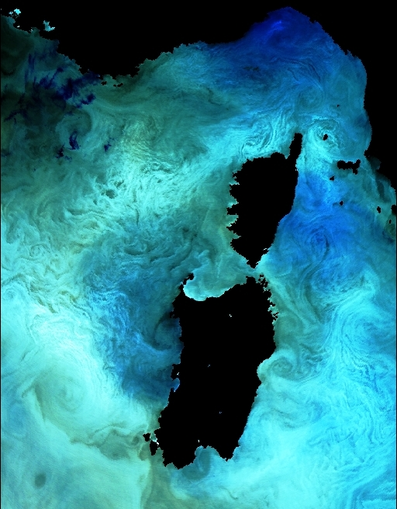
Key Improvements: SLSTR vs AATSR…
Increased number of spectral bands from 7 to 9 (new 1.3 and 2.2um) for better Ci Cloud detection
Increased spatial resolution for VIS and SWIR channels (0.5 km @ nadir, TIR 1 km @nadir)
Along track scanning with increased swath:
  oblique swath to 740 km
  nadir swath to 1400 km
100% overlap with OLCI
Improved coverage < 4 days global ocean (practically ~ 2 days)
Dedicated Active Fire channels
Better timeliness: 3 hours NRT Level 1/2 products
Thermal Structure in the Med, ENVISAT AATSR

Slide 16
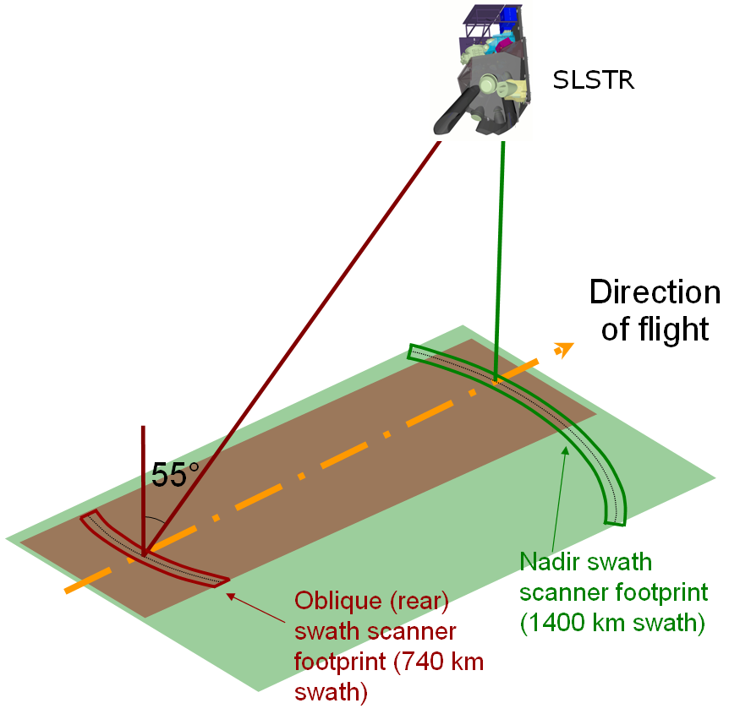
S3 SLSTR: Basic Geometry
Uses two scan mechanisms and a flip mirror to enable wider swath
Nadir swath is offset to cover OLCI swath
One VIS channel (865nm) is used for co-registration with OLCI swath
Oblique view 55 deg inclination maintains a longer atmospheric path length (1.5atm) compared to nadir for better atmospheric correction
Oblique view is ‘backwards’ relative to flight direction (Orbit, solar illumination, emissivity => algorithm updates needed) ➔ Overlap between AATSR and SLSTR is fundamental

Slide 17
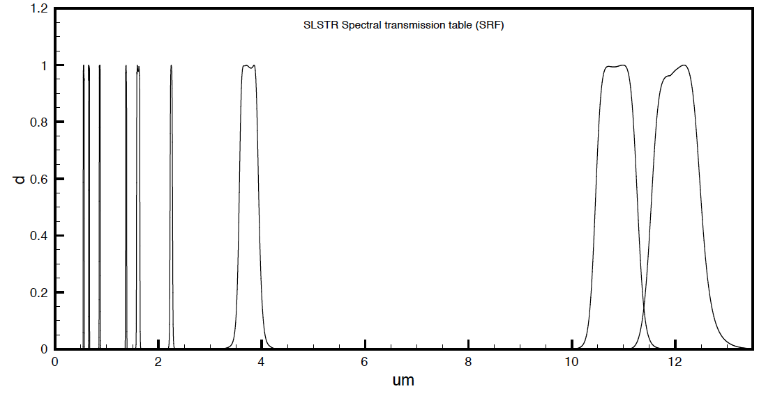
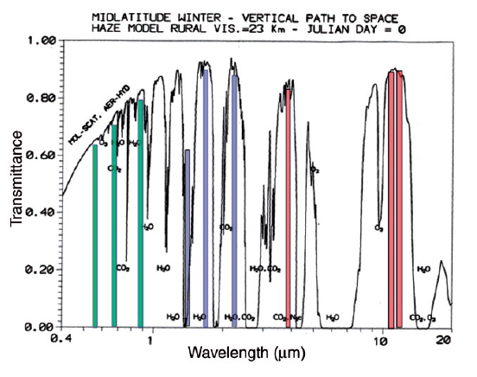
S3 SLSTR: Spectral Bands
Absolute rad. Accuracy VI/SWIR S1–S6:
<5% (EOL)
<2% (BOL)
Absolute rad. Accuracy TIR S7/8/9: 0.2K
(goal: 0.1K)
Polarisation sensitivity:
S1–S6: < 0.07
S7/8/9:< 0.10
Stability:
S1–S6: <0.1%
S7/8/9: <0.08K
SLSTRBand | λcenter [μm] | Δλ [μm] | SNR [-] / NeDT [mK] | SSD [km]
S1 | 0.555 | 0.02 | 20 | 0.5
S2 | 0.659 | 0.02 | 20 | 0.5
S3 | 0.865 | 0.02 | 20 | 0.5
S4 | 1.375 | 0.015 | 20 | 0.5
S5 | 1.61 | 0.06 | 20 | 0.5
S6 | 2.25 | 0.05 | 20 | 0.5
S7 | 3.74 | 0.38 | 80 mK | 1.0
S8 | 10.95 | 0.9 | 50 mK | 1.0
S9 | 12 | 1.0 | 50 mK | 1.0
F1 | 3.74 | 0.38 | 500 | 1.0
F2 | 10.95 | 0.9 | 400 | 1.0
SLSTR SRF Available from ESA
Contact craig.donlon@esa.int
SLSTR is an IR self-calibrating instrument using on-board calibration device (blackbody cavities for TIR; Solar diffuser for the VIS-SWIR)
AATSR Heritage
SLSTR New Bands

Slide 18
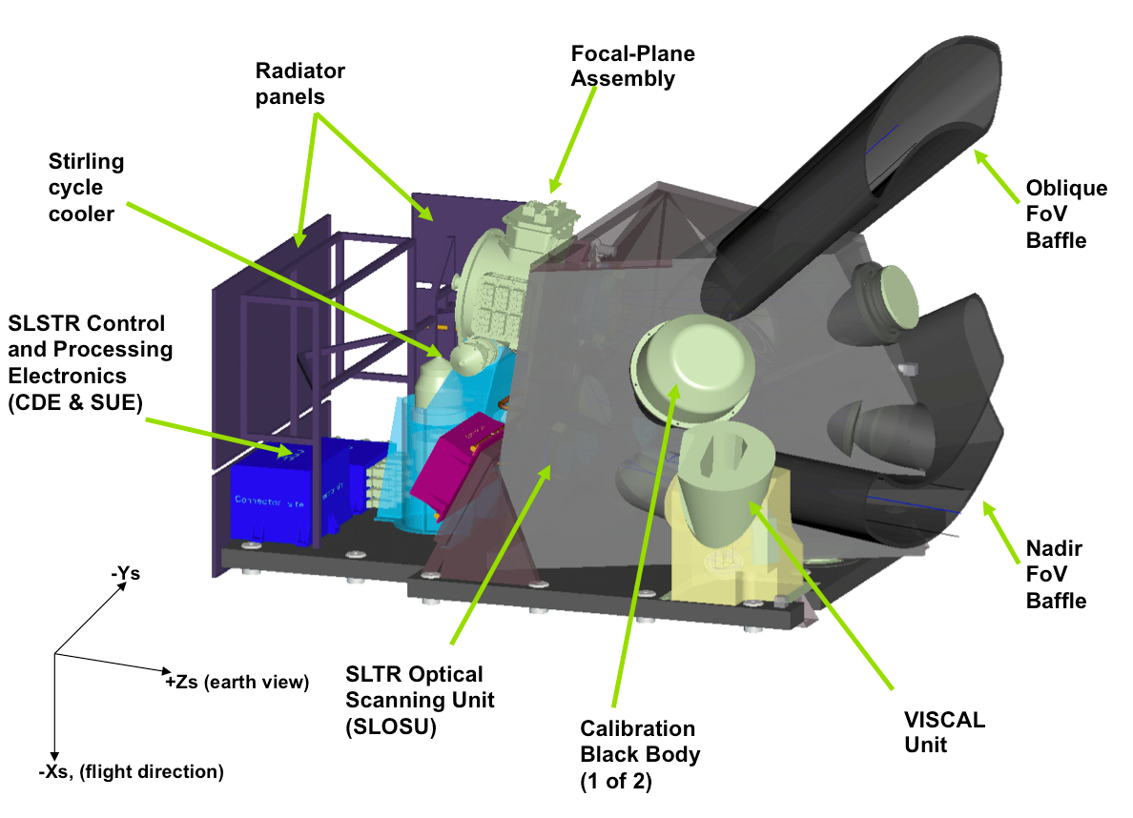

Slide 19
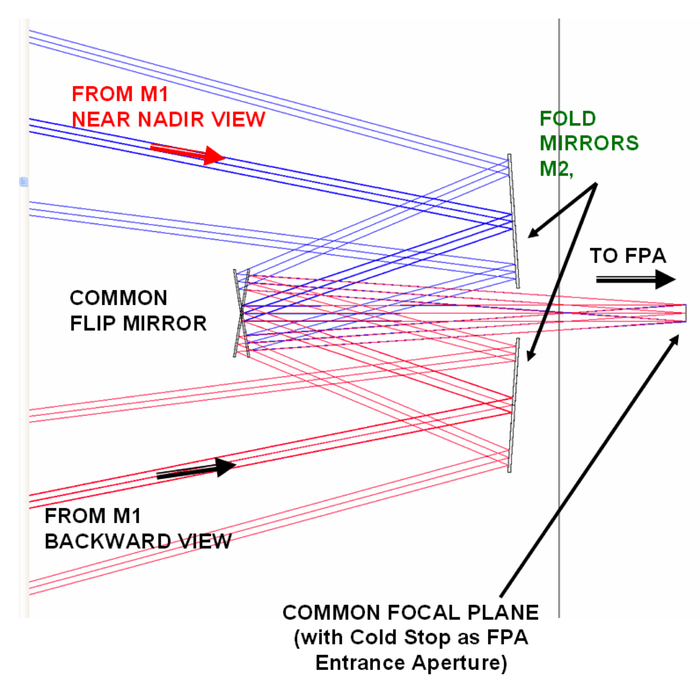
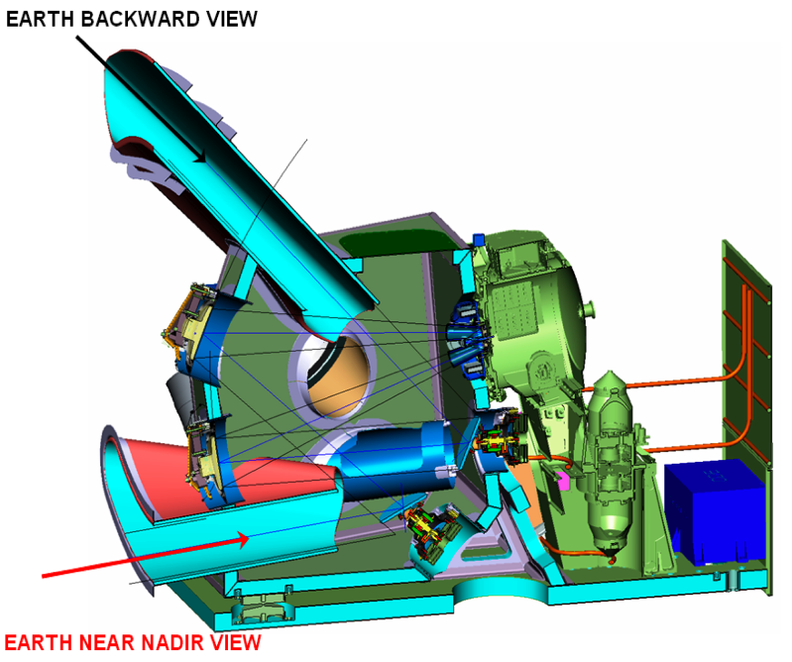
S3 SLSTR: Scanning overview
The dual scan is based on two flat rotating mirrors and one flip mirror - switching between one view and the other
Each scan measures 2 Earth scan lines (multiple element detector arrays)
The scan mirrors rotate on a 300 msec time basis, ~half period of AATSR
The in flight calibration period is 600 msec
Each calibration source is seen by each view once every second scan cycle
Notes:
The dual scan is based on two flat rotating mirrors and one flip mirror switching from one view to the other
The scan mirrors rotate on a 300 msec time basis, half of AATSR
The in flight calibration period is 600 msec, since each calibration source is seen by each view once every second scan cycle
Each view uses its own scanner (flat scan mirrors)
Each scan includes 2 IFOV earth views, calibration sources (BBs, VISCAL)
Views are seen by the front collecting and refocusing optics (Primary Mirrors)
Recombination optics to bring 2 optical paths into a single set of Focal Plane assemblies (FPA) after a common field plane used as intermediate field stop

Slide 20
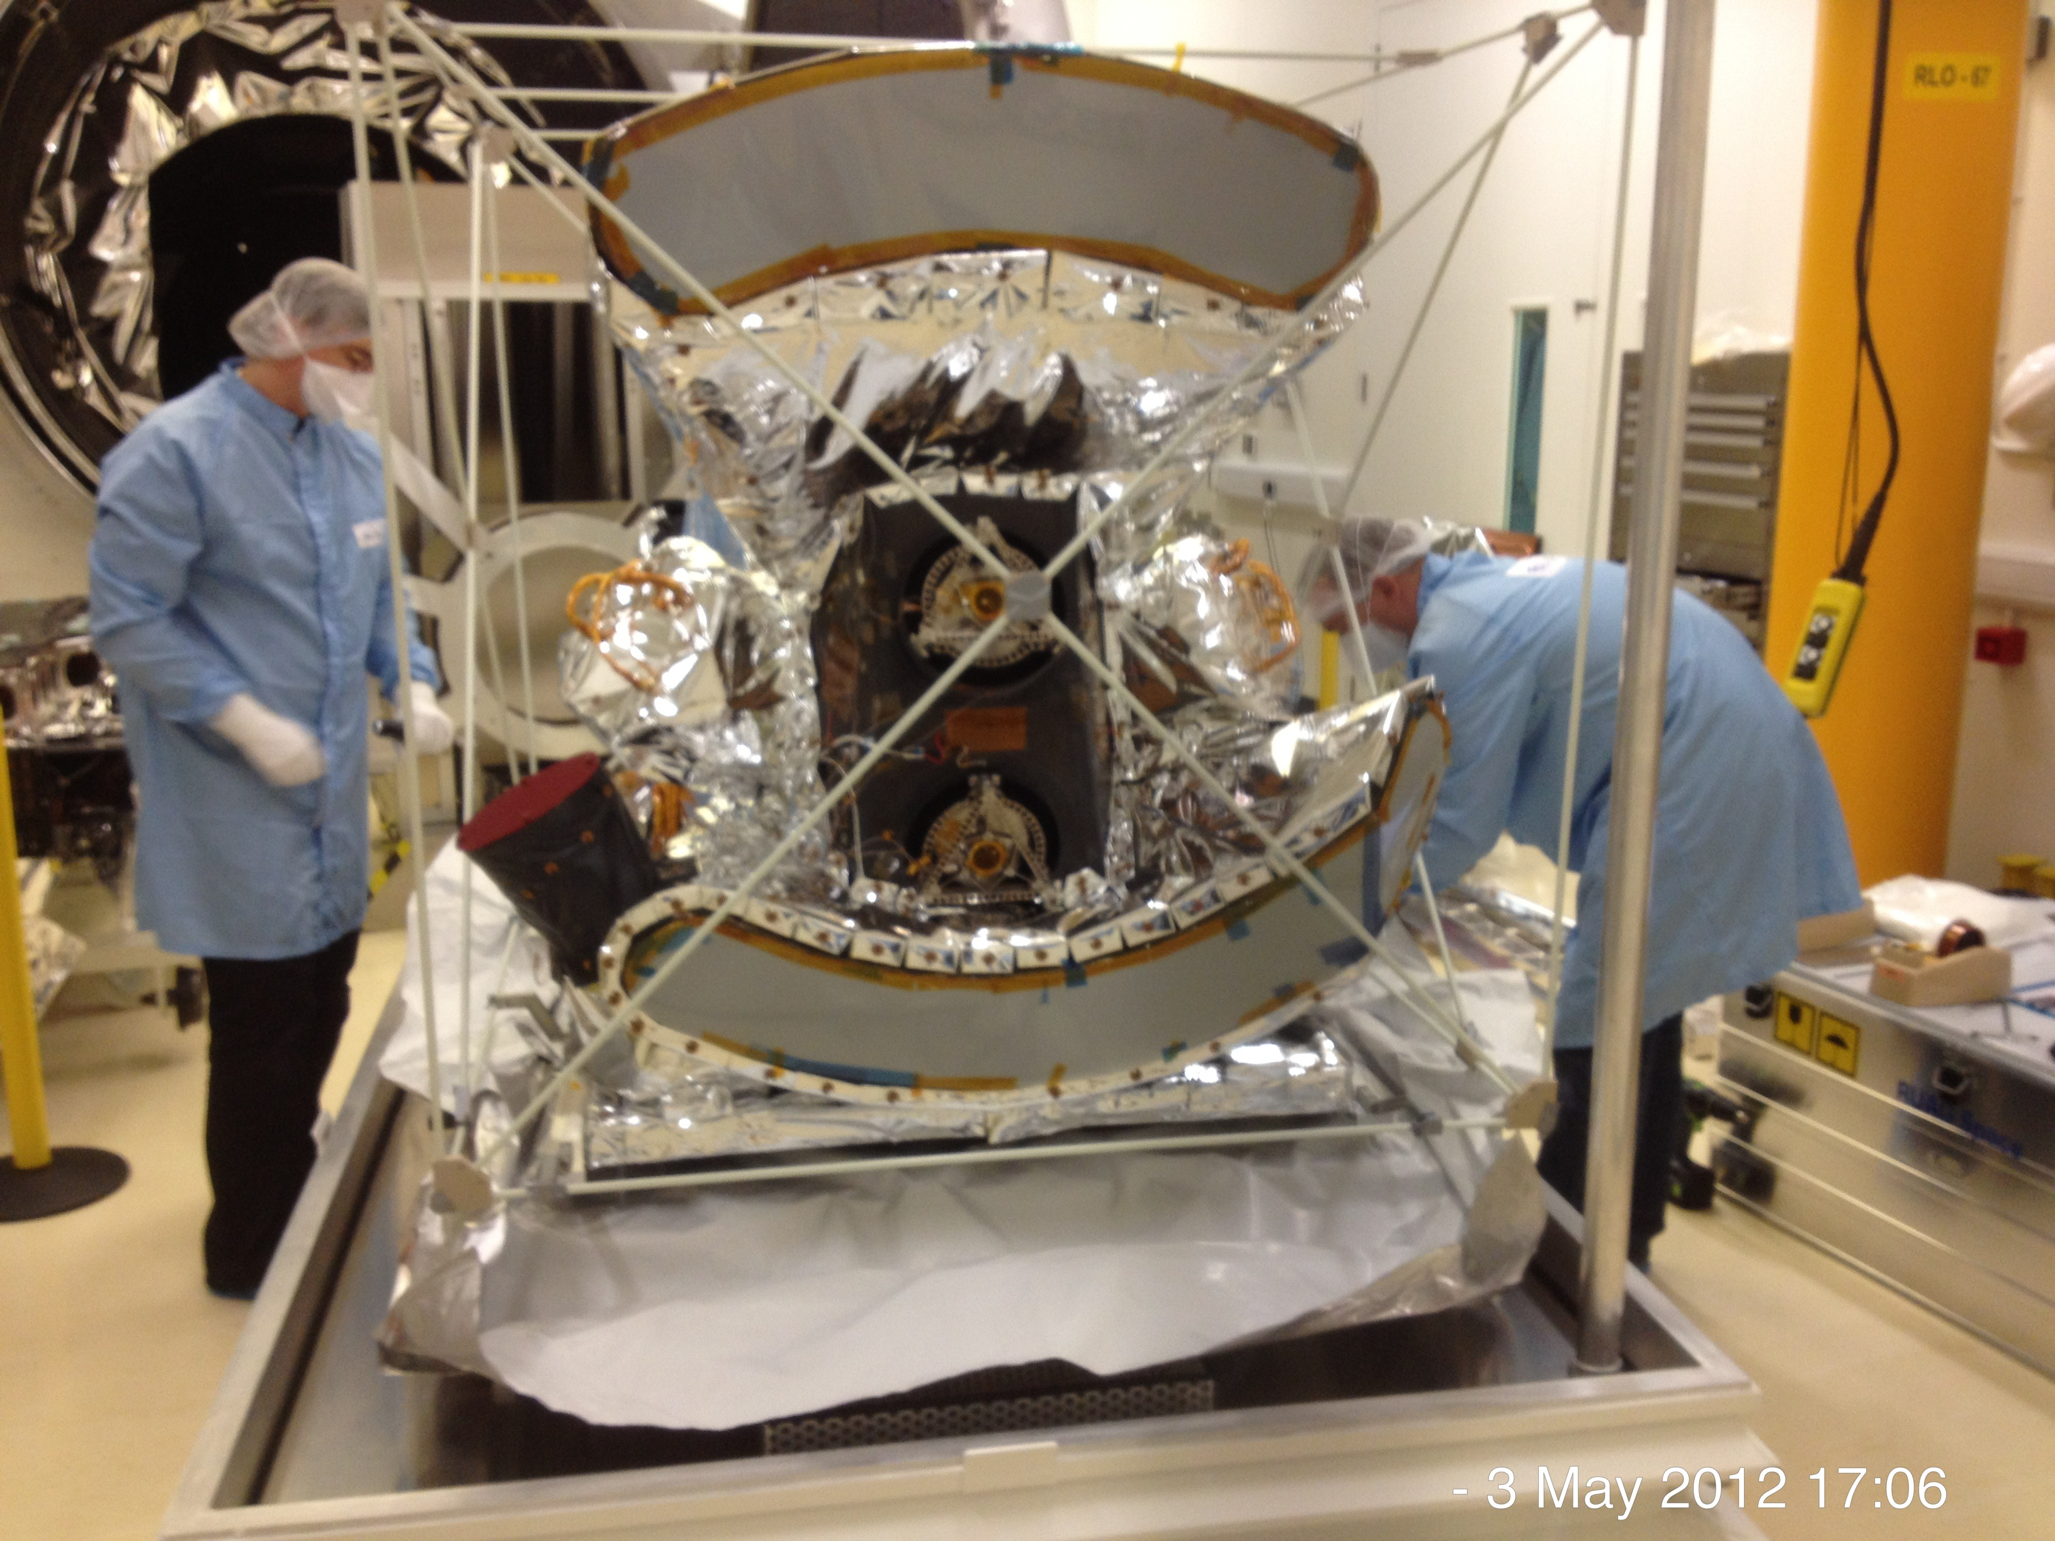
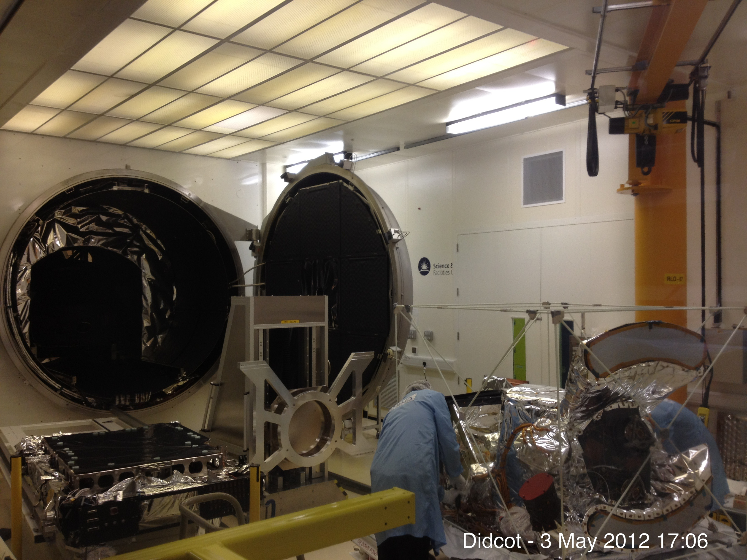
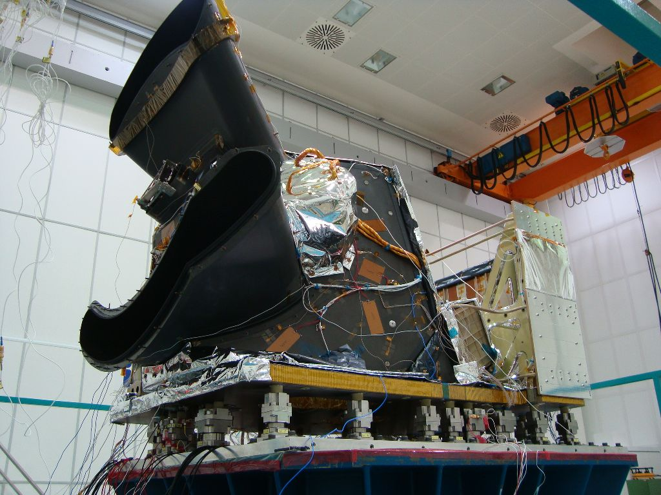

Slide 21
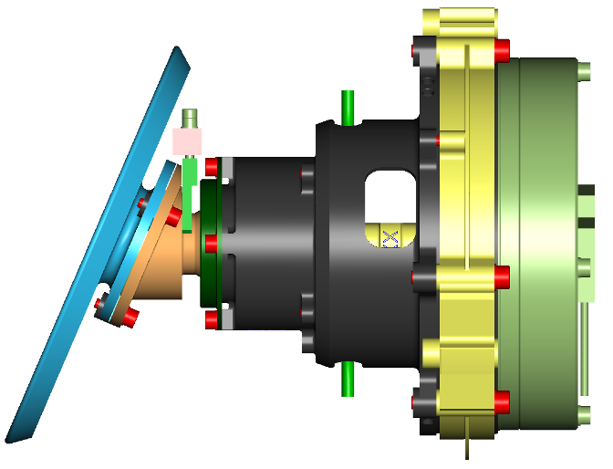
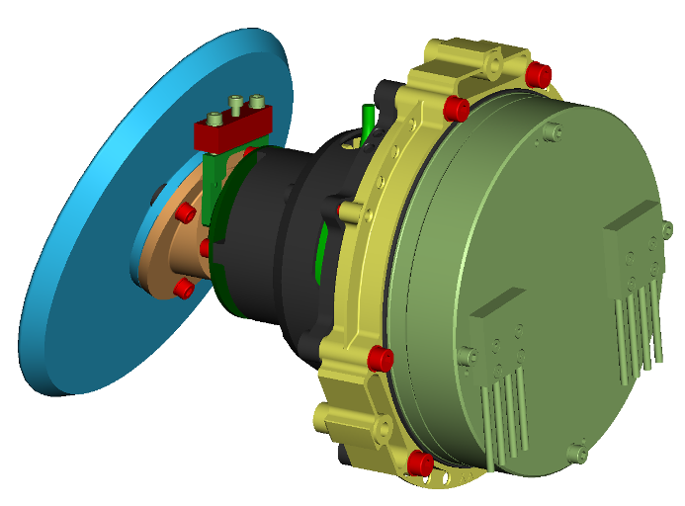
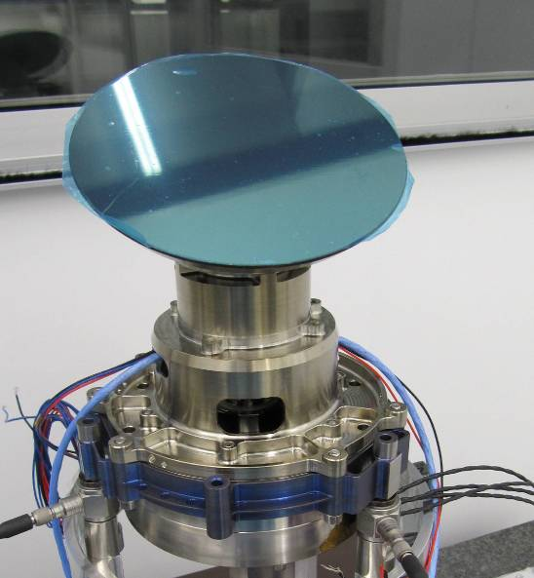
SLSTR Scanners
    Motor
      DC brushless, low cogging, 24poles
    Encoder
      optical, 21bit resolution, 8 arcsec accuracy
    Bearings
      solid lubrication, PGM-HT cages, soft preloaded
    Scan Mirror Assembly
      Beryllium Mirror with protected Silver coating
    pointing accuracy
      operational: 6.2arcsec RMS
      fixed position mode: 4arcsec pp
    optical performance
      free aperture: 110mm
      surface flatness: <16nm RMS
      surface roughness: < 1nm RMS
      scan cone angle: 46,573° +/- 0.006°
      transmission: R=0.95 EOL
      polarisation sensitivity: <0.3%

Slide 22
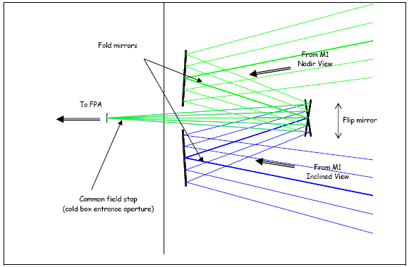
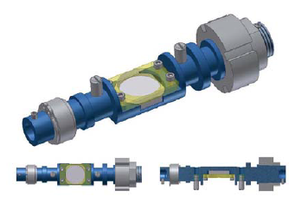
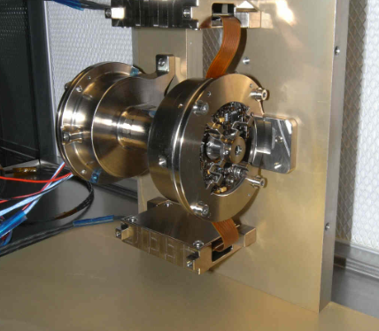
OME Flip Mirror System (FMS)
  Key Components
    mechanical assembly FMA
      FMA base mount
      FMD with flip mirror (FMI)
      Flip Baffles
      Foldmirrors
    controlled by FMC (in SUE box)
  Key Performance
    2 transitions from NA to OB
    within 300ms scansync cycle
    max. transition time 34 ms
    repeatability and stability
    15 arcsec
    switching range +/- 18.8°

Slide 23
SLSTR Scan Duty Cycle
1
EARTH
EARTH
0
Ob
Normalised Flip Transition
and Scan throughput
(Nadir and Oblique)
Na
1
EARTH
EARTH
EARTH
0
0 200 300 400 600
Time (ms)
1 Scan period
1 Cycle Period (= 2x Scan Period
Cold BB view
Flip state
Hot BB view
Nadir scanner throughput
VISCAL view
Oblique scanner throughput
Notes:
Each one of the two blackbodies is seen by each one of the two scanners once every second scan cycle for 16 pixels (pixels equivalent to 1km on ground)
The VISCAL is seen by each one of the scanners once every second cycle for 16 pixels (pixels equivalent to 500m on ground).
Green shows the flip state

Slide 24
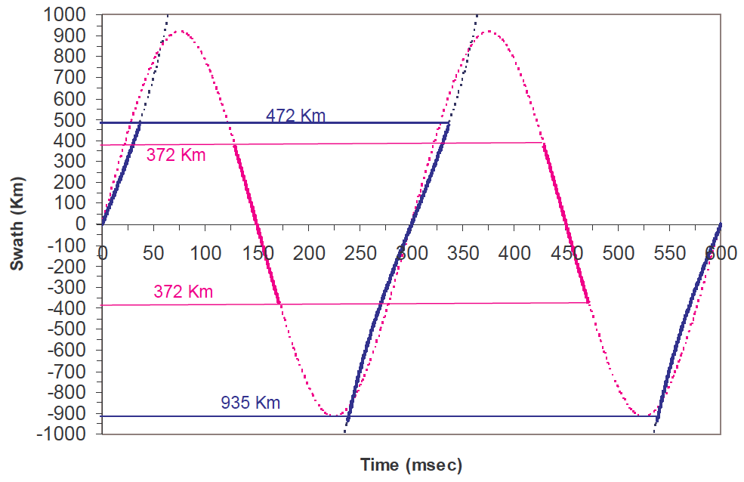
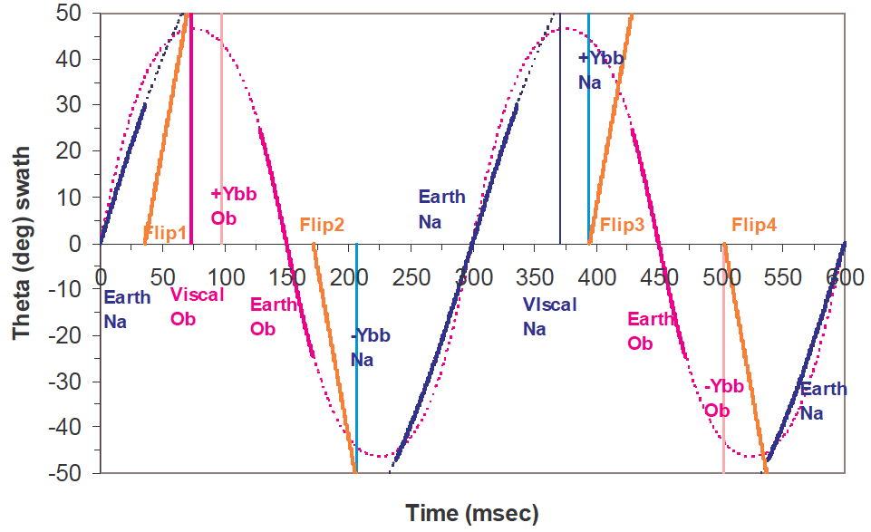
Scan sequence
Notes:
FoV projected in the across-track direction as a function of scan time for a complete “Cycle Period” (that is two scan periods where Tscan=300 msec, H=800 km). Blue is nadir and pink is oblique. Orange cureve is flip mirror transition. +tive is Eastwards
On-ground swath in the across track direction as a function of scanning time (H=800 km)
Scan rotation angles for each target in a cycle period (2 scan periods)

Slide 25
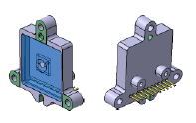
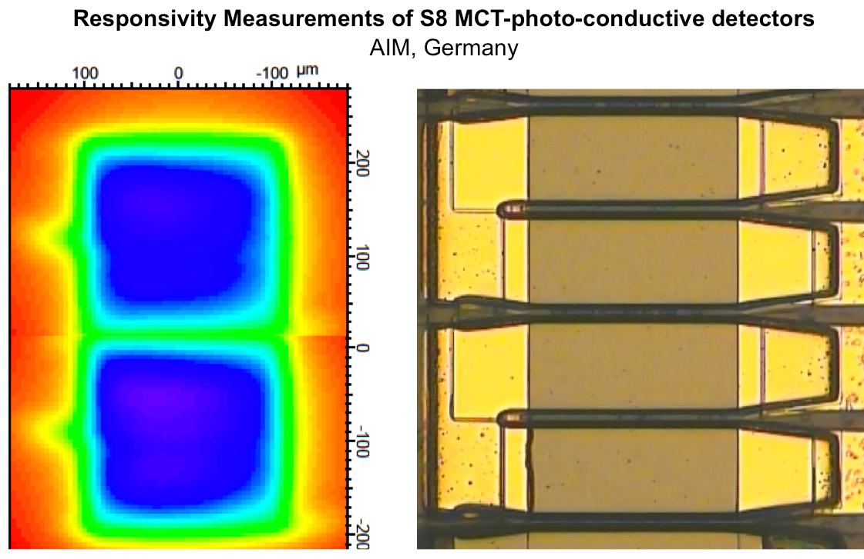
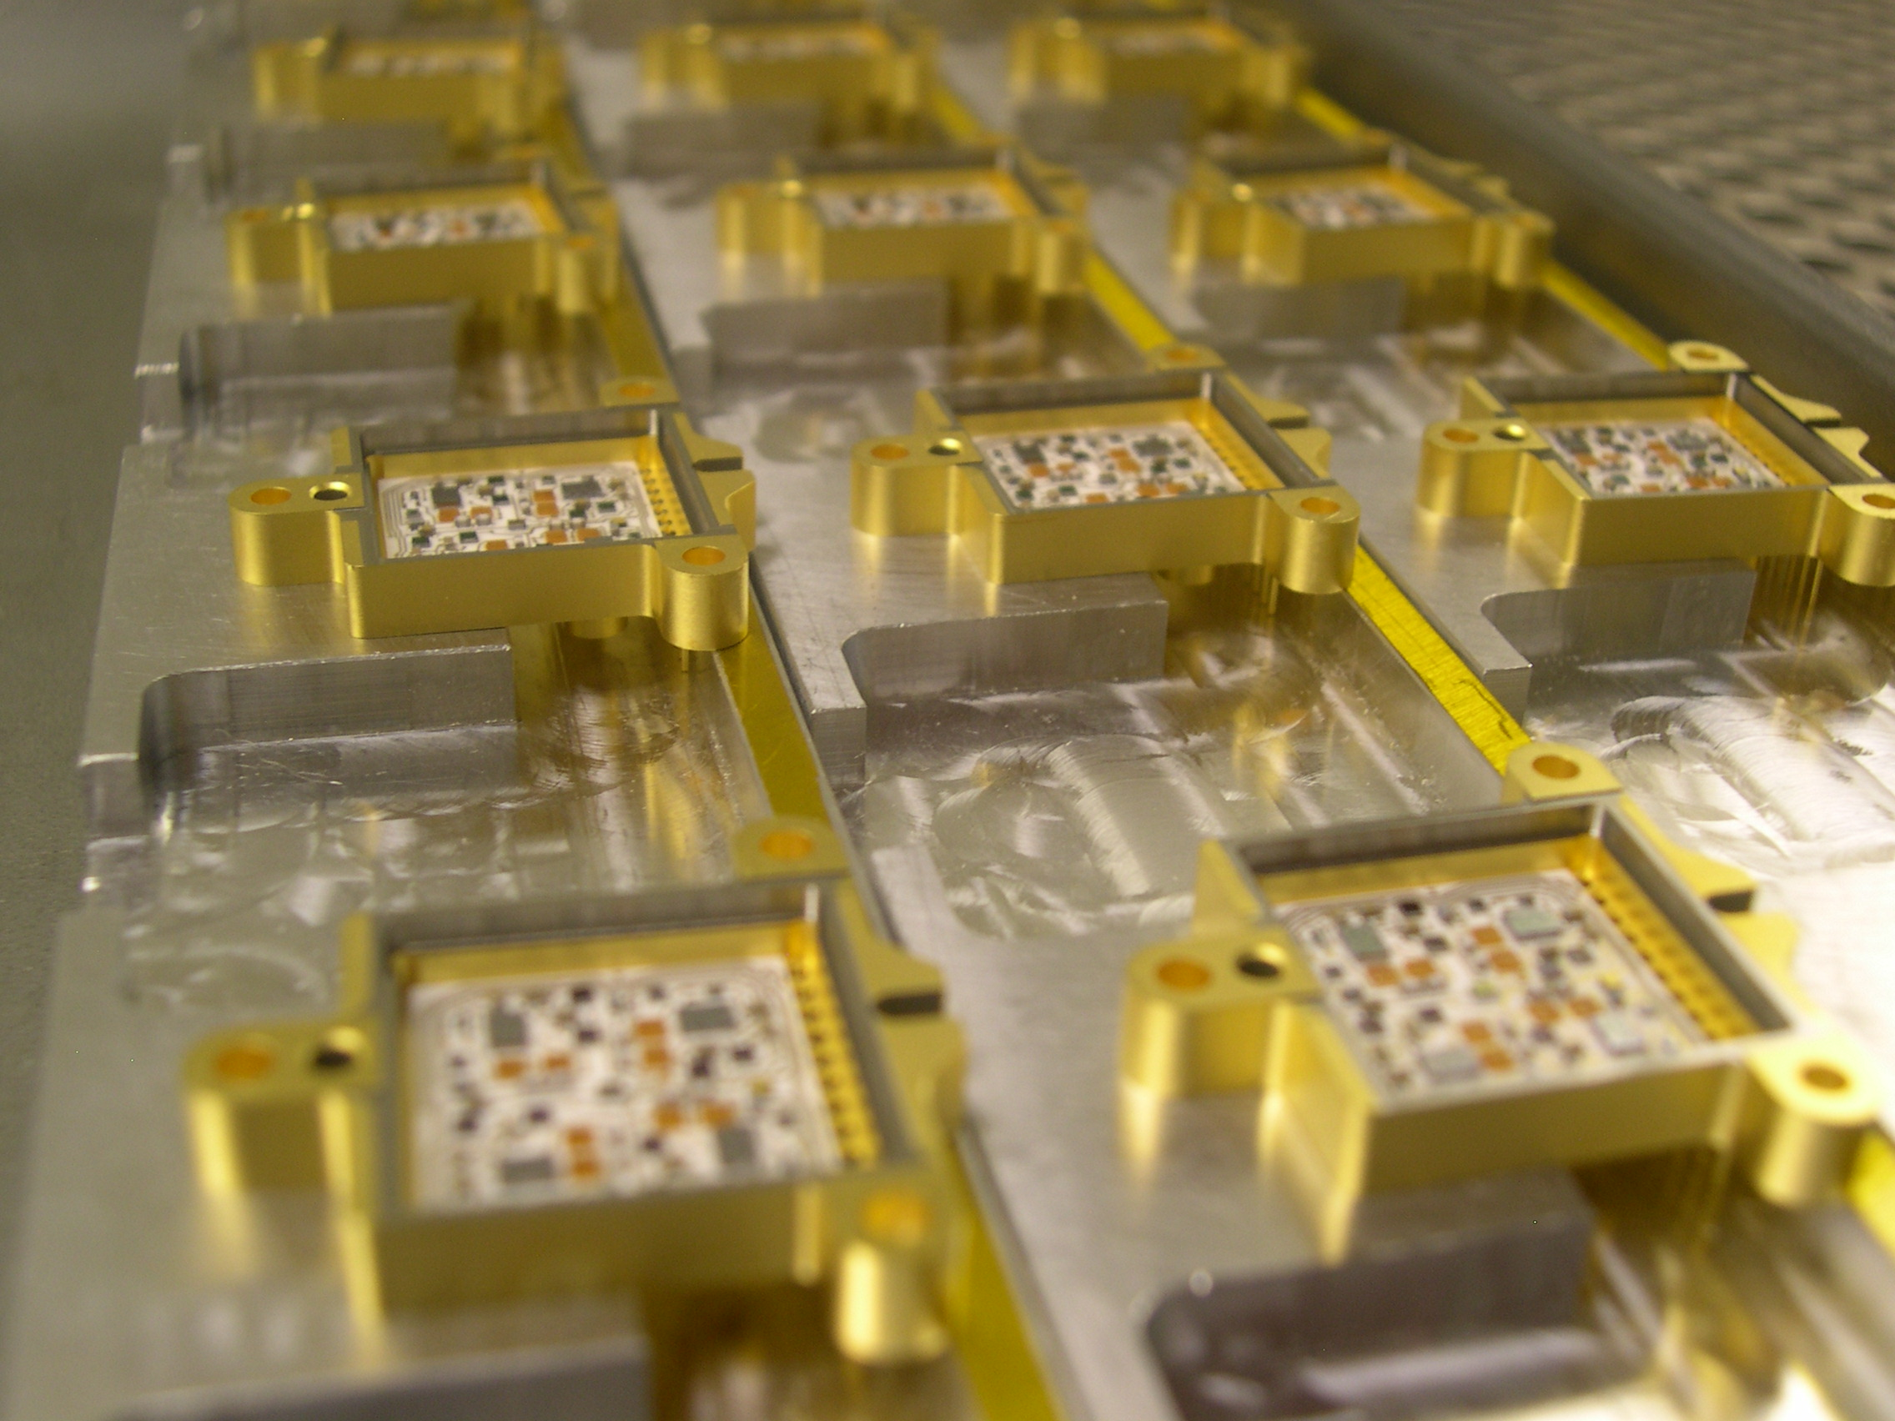
SLSTR Detectors
S1-S3 (VIS): Si Photo Voltaic
S4-S6 (SWIR): MgCdTe Photo Conductive
S7 (MWIR): MgCdTe Photo Conductive
S8-S9 (TIR): MgCdTe Photo Conductive
F1 (MWIR): Implemented as additional wafers on S7 detector
F2 (TIR): Implemented on S8 using additional gain setting
The use of detector arrays is a major change from AATSR single element detectors
This is required because of the scanning design
Notes:
1. One of the main changes wrt. respect to AATSR VIS channels is the use of a 4x diode array instead of a
single diode per channel.
2. SWIR use a 2x4 array instead of a single detector
3. TIR uses a 1x2 array
4. F1: Implemented as additional wafers on S7 detector
5. F2: same as S8 but with different gain

Slide 26
SLSTR Detector Configuration
Channel | Center | Δλ
S1 | 0.55 | 0.02
S2 | 0.659 | 0.02
S3 | 0.865 | 0.02
S4 | 1.375 | 0.015
S5 | 1.61 | 0.06
S6 | 2.25 | 0.05
S7 / F1 | 3.74 | 0.38
S8 / F2 | 10.85 | 0.9
S9 | 12 | 1.0
S4-6
2 x 4 pixels
pixel size: 100 x 100 μm
integration time/pix: 35μs
F# ~ 1.43
GSD: 0.5 x 0.5 km
Transfer of all pixels to ground => on-ground TDI
photo-voltaic detectors
1 x 4 pixels
pixel size: 205 x 205 μm
integration time/pix: 35µs
F# ~ 3
GSD: 0.5 x 0.5 km
Silicon Detectors
S1-3
100 μm
S7
S8 - S9
100 μm
2 pixels
pixel size: 200 x 200 μm
integration time/pix: 70μs
F# ~ 1.43
GSD: 1.0 x 1.0 km
photo-conductive detectors
one blind pixel
F2: same as S8 pixel higher dynamic range through additional gain and amplifiers.
integration time/pix: 10 µs
S7.1: 1 x 2 pixels
pixel size: 200 x 200 μm
integration time/pix: 70μs
F# ~ 1.43
GSD: 1.0 x 1.0 km
photo-voltaic detectors
one blind pixel
F1: 1 x 4 pixels
pixel size: 25 x 100 µm
integration time/pix: 70 µs
F# ~ 1.43
GSD: 1.0 x 1.0 km (binned & integrated)
205 μm
25 μm
200 μm
200 μm
ALONG SCAN
ALONG TRACK

Slide 27








SLSTR Focal Plane Array (FPA)

Slide 28





SLSTR: SWIR/TIR FPA (80 K)
FPA SWIR/TIR Side S7, S8 and S9
FPA SWIR Side S6, S4 and S5 (Lower right is lens to focus and feed the VIS detectors)

Slide 29

SLSTR: FPA window and optical input
Window is required for on-ground testing

Slide 30

SLSTR: VIS FPA (~260 K)
FPA VIS Box S2, S1 and S3

Slide 31



SLSTR Stirling-Cycle 50-80K Cryo-cooler
Cold fingers
← Flexible Thermal link assembly
SLSTR FPA is cooled to ~80K by two Astrium 50-80K single-stage Stirling coolers.
Over 140 flight-years of heritage
Notes:
A cryogenic cooling system is required by SLSTR to provide the thermal environment
necessary for operating the instrument's infra-red detectors. The CCS uses the 50-80K Stirling cycle cooler forming the building block of the Cryo-
Cooling System (CCS). The fact that this class of cooler (both 50 - 80 K coolers and 80 K predecessor) has accumulated over 140 years of in-flight use clearly reveals that they
should be more than capable of meeting and exceeding the lifetime requirements of Sentinel 3.
SLSTR IR detectors are required to operate at ~80 K in order to obtain the required performance.
The Cryo-Cooler System (CCS) is designed around heriage
- Cooling is provided by two Astrium 50-80K single-stage Stirling coolers (as used on MOPITT, MIPAS, AATSR, INTEGRAL, and other programmes)
- The coolers are mounted on the SLSTR structure using a dedicated bracket with the aim of minimizing the overall mass
- The two cold-tips are linked to the cryobench using flexible links which allow relative displacement between the cooler assembly and the cryobench, which are
expected to occur as a consequence of thermoelastic effects (both on ground and in flight) and vibrations (during launch)
- The coolers are driven by a Cooler Drive Electronics (CDE)
- Accelerometers are used to sense the out of balance forces in the cooler system and an algorithm in the CDE uses this information to minimize the exported
micro-vibrations by modifying the drive waveform of one cooler
- A flexible bellows assembly (FBA) is used so that the vacuum space in the cryostat can be sealed during ground test but does not require decoupling before
launch; the FBA therefore is capable of allowing relative displacement between the cryocooler assembly and the FPA during launch

Slide 32

S3 SLSTR: Calibration
SLSTR is a self-calibrating IR instrument.
SLSTR uses an on-board calibration system:
  - TIR channels use two specially designed and highly stable blackbody cavities observed every scan
  - Fire Channels rely on pre-launch calibration and use of hot BB (dynamic range >600 K) as best effort
Vicarious VIS/SWIR calibration
  Solar diffuser illuminated once per orbit at
  at the the S. Pole terminator.
Additional regular views of
stable earth sites (Desert,
snow) used to characterize /
correct for calibration drift.
Notes:
SLSTR in flight calibration blackbodies:
Based on ATSR heritage
Also GERB, MIPAS, IASI…
Provides a two point calibration for the three thermal IR channels
two cavities for 2-point calibration
one cold black body will drift at optical bench temperature (T ≈ 260 K)
one hot black body will be heated with constant power (T ≈ 305 K)
Key Requirements:
Effective emissivity > 0.998 averaged over the viewed area
Temperature non-uniformity (for the target area) < 0.02 K
Temperature measurement error <0.02 K BOL with a maximum drift of 0.03 K EOL
Temperature stability <0.0003 K/s

Slide 33


SLSTR Black Body Cavities
Black body cavities of heritage design (A)TSR, IASI
Thermally isolated with MLI insulation
BB1 at instrument temperature (~260 K) and BB2 heated to ~300 K
Both cavities are viewed separately by each scan chain every Cycle Period (two scan periods)
Effective ε >0.998
8 PRT sensors + 32 Thermistors
T° non-uniformity < 0.02 K
T° Abs. Accuracy 0.07 K
T° error BOL <0.02 K
T° stability < 0.3 mK/s
Notes:
effective emissivity > 0.998 averaged over the viewed area
Temperature non-uniformity (for the target area) < 0.02 K
Temperature measurement error <0.02 K BOL with a maximum drift of 0.03 K
EOL
Temperature stability <0.0003 K/s
Uses 8 precision temperature sensors and 32 Thermistors.

Slide 34


SLSTR Visible Calibration (VISCAL)
VISCAL provides a gain calibration for VIS channels
Direct heritage from the A(A)TSR series
Illuminated by the sun once per orbit and baffled to prevent views of earth or atmosphere and satellite
Includes a Sun Sensor having clear view to the full diffuser giving a signal proportional to incoming radiation
Diffuser material is Zenith (identical lot to OLCI)

Slide 35

SLSTR: Standards traceable Verification process
(component procurement up to calibration)

Slide 36

SLSTR Calibration Facility
Earth Shine Plate
Alignment Optics
Facility commissioning completed 19th March 2012
STM Integrated & MLI fitted 28rd March
Tests with STM completed (successful)
PFM Testing scheduled for Q2 2013
Point source + collimator
Instrument
Electronics
Blackbody Source
Platform Simulator
ESA requirement to perform calibration tests under flight representative conditions.
  Thermal balance
  Steady State
  Instrument fully operational
Notes:
Demonstrate that the 'on-board' radiometric calibration works under flight representative thermal conditions.
BOL and EOL conditions
Simulated orbital transient thermal conditions
Perform the 'on-board' radiometric calibration for a range of target temperatures between 210K and 320K.
Verify the absolute accuracy of the on-board calibration against external targets
Verify that each IR channel produces self consistent results in both views
Measurement of radiometric noise vs. scene temperature
Measurement of signal channel non-linearity to provide appropriate corrections
Verify the calibration around the full instrument field-of-view
Determine and measure any scan dependent variation in the radiometric performance.
Determination of swath width to verify required clearance at ends of swath
Measure the effect on the radiometric calibration vs. detector temperature.
Verify the calibration with the on-board black-bodies set at different power levels.

Slide 37





SLSTR testing (3/3)
  Selected results:
  Flip mirror:
  difference between commanded and measured (by the encoder) position.
  In the graph the flip mirror error is reported in red vs CYCLESYNC (2 minutes of cycles are over imposed).
  In blue the Flip mirror position is reported (scaled) as reference.
  FEE noise:
  Test was performed with the FEE commanded by the CPE with the same configuration of the test done at SS level without over sampling.
  PFM FPA test in air:
  FPA Thermal load verification in TVC with Cooler GSE
  Preliminary Detector alignment / Shim determination with EM DU S4,5,6, and Flight DU S1,2,3,7, without along scan visible field stop pinhole in the intermediate focal plane.
IR bench
VIS bench
PFM FPA TVC 1st run

Slide 38




SLSTR STM integration @ RAL
  Selected results:
  Facility blank thermal test was completed.
  Thermal limit and stability of the target radiators and blackbodies was verified.
  Integration of the STM in te RAL facility was successful completed by JOP and RAL personnel, SG was present at the integration.
  mechanical IF are OK
  Electrical check out with the EGSE was successfully performed.
  Thermal test completed.
STM SLOSU and external Blackbody Temperatures during hot TB case.
STM Thermocouples During Orbital Simulation
White – Nadir blackbody, yellow – Oblique blackbody

Slide 39


Borderline SZA < 80°
start of OLCI sensing
Eclipse zone
Operations based o a Position Timeline (repeating every 385 orbit)
SLSTR (no S1-4 channels) & SRAL/MWR sensing;
Orbit manoeuvres
SLSTR, OLCI & SRAL/MWR sensing
SLSTR, OLCI & SRAL/MWR sensing
OLCI & SLSTR Solar calibration
(OLCI: 2x per month
SLSTR: 1 per orbit)
Borderline SZA > 80°
End of OLCI sensing
Notes:
S3 has highly autonomous onboard operations:
Continuous acquisitions for SRAL, MWR and SLSTR SWIR 2&3, TIR and FIRE channels
For OLCI and SLSTR VIS and SWIR 1 channel acquisition only over sun illuminated ground track (SZA < 80deg)
Operations based on Position Timeline (repeating every 365 orbit)
- SRAL LRM/SAR mode commanding (depending terrain)
- SRAL Calibration mode commanding
- OLCI Calibration mode commanding
- S-band and X-band commanding

Slide 40
S3: Data processing chains
OLCI Instrument
SLSTR Instrument
SRAL Instrument
MWR Instrument
POD System
OLCI L1B
SLSTR L1B
L1C
Topography Processing chain based on altimeter radiometer and POD system data
Ocean & Land Colour Processing
chain based
on OLCI data
Surface Temperature Processing
chain based
on SLST data
L1C: Hybrid
processing
chain based on combination of SLSTR and
OLCI data
Ocean & Land Colour L2 Products
L2 Surface Temperatures Products
L2 Surface Topography Products
Synergy Products
Product delivery timeliness:
Near-Real Time (< 3 hr) availability of L2 products (and L1b)
1 to 2 days delivery of higher quality topography products for assimilation in models
Notes:
40

Slide 41




ESA’s Earth Observation data
Respective data policies
Sentinel Data Policy
Full and open access to Sentinel data to all users
In practical terms
Anybody has the right to access acquired Sentinel data
Licenses for the Sentinel data are free of charge
However the funding for the actual access in routine phase is under discussion with EU
ERS and Envisat
Earth Explorers
Sentinels
Revised ESA Data Policy for ERS, Envisat and Earth Explorer missions
ESA/PB-EO(2010)54
Joint Principles for a Sentinel Data Policy ESA/PB-EO (2009)98
Contributing missions (to GMES) and
Third Party Missions
Data Policy of individual data providers
Feb 2010
Notes:
41

Slide 42

Access to S3 Data from the Sentinel-3 PDGS
Interactive data request
ESA
User Services
Direct download Using ngEO Download Manager
Direct download from Web Browser
Subscription to predefined datasets
Direct download Using ngEO Download Manager
Direct data request
Online access to data
Access to FTP servers at land PDGS centres
Interactive data request
EUMETSAT
User Service
Direct download Using UMARF
Subscription to predefined datasets
Direct download Using UMARF
Via EUMETCAST
Direct data request
Online access to data
Access to FTP servers at the marine PDGS centre

Slide 43
Sentinel – 3 Core GS
User Products list
LEVEL 1
- OLCI L1B
- SLSTR L1B
LEVEL 2
- OLCI ocean color
- SLSTR sea
- SRAL L2
LEVEL 2
- OLCI Land
- SLSTR Land
- SYNERGY / VGT
- SRAL L2
Level 1
ESA/EUMETSAT
Marine products
EUMETSAT
Land products
ESA
Satellite Operated by EUMETSAT

Slide 44
Sentinel-3 Core PDGS
Optical geophysical parameters list
Geophysical Product
Application
Domain
Spatial Resolution
Continuity
Measurement Source
Normalised Water Surface Reflectances
300 m , 1.2 km
Envisat
OLCI
Chlorophyll Concentration for open ocean waters
300 m , 1.2 km
Envisat
OLCI
Chlorophyll Concentration for Coastal waters
300 m , 1.2 km
Envisat
OLCI
Total suspended Matter
300 m , 1.2 km
Envisat
OLCI
Diffuse attenuation coefficient
300 m , 1.2 km
GCM* (e.g. Modis)
OLCI
Coloured Detrital and Dissolved Material
300 m , 1.2 km
Envisat
OLCI
Photosynthetically active radiation
300 m , 1.2 km
Envisat
OLCI
Aerosol Optical Depth over water
300 m , 1.2 km
Envisat
OLCI
Aerosol Angstrom exponent over water
300 m , 1.2 km
Envisat
OLCI
Integrated Water Vapour Column
300 m , 1.2 km
Envisat
OLCI
Sea Surface Temperature
1 km
Envisat
SLSTR
Land Surface Temperature
1 km
Envisat
SLSTR
Fraction of Absorbed PAR
300 m , 1.2 km
Envisat
OLCI
Terrestrial Chlorophyll Index
300 m , 1.2 km
Envisat
OLCI
Surface Reflectances over Land
300 m
Envisat
OLCI+SLSTR
Aerosol Optical Depth over Land
300 m
Envisat
OLCI+SLSTR
Aerosol Angstrom exponent over Land
300 m
Envisat
OLCI+SLSTR
Vegetation-like Surface Reflectances 1 day Synthesis
1 km
Vegetation
OLCI+SLSTR
Vegetation-like Surface Reflectances 10 days Synthesis
1 km
Vegetation
OLCI+SLSTR
Vegetation Normalised Difference of Vegetation Index
1 km
Vegetation
OLCI+SLSTR

Slide 45



Sentinel-3 Core PDGS
L2 LAND / MARINE Production
L2 Optical production organisation
L2 SRAL production organisation
Example of geophysical product:
OLCI Terrestrial Chlorophyll Index (OTCI)
Chlorophyll Concentration for open ocean waters (CHL_OC4ME)
Measurements included in the MARINE product
Measurements included in the LAND product
Land products
Marine products
The Land and Water masks are perfectly complementary.
*The cloud mask is provided in white for a better interpretation of the information.
*The Land and Water masks are in overlap to ensure analysis of transition and meaningful continuity of segments

Slide 46
Optical Sensor: Sentinel-3 Core PDGS Production

Slide 47

S3 PDGS Data volume
(uncompressed)
Ground Segment Designed to provide GHRSST L2P format SSTskin from Conception
(ARC/SST_cci retrieval but no Bayesian cloud…yet)
 | Level 0 GB/Orbit | Level 1 GB/Orbit | Level 2 Marine GB/Orbit | Level 2 Land GB/Orbit
OLCI | 9.5 | 29.6 | 35.5 | 7.8
SLSTR | 4.8 | 45.6 | 5.8 | 2.8
SYN (OLCI+SLTSR) |  | 55.8 |  | 31.2
SRAL + MWR | 5.8 | 0.12 | 0.09 | 0.07
Total (GB/orbit) | 20.1 | 131.12 | 41.39 | 41.87
ENVISAT AATSR L1 GBTR ~0.7GB/orbit
Notes:
Comparison with Similar ENVISAT instruments products:
AATSR L1 GBTR ~0.7 GB /orbit

Slide 48

Early S3 Mission Timeline: Cal/Val
No data available
Limited L0/L1 data from payload for cal/val: – systematic production and dissemination ramped-up
Gradual ramp-up of all products in early phase
Notes:
Instrument calibration and operational product validation phase
Bring the overall satellite into operational state
Activate (successively) all payload modes and all related ground processing
Characterize mission data acquisition and related ground processing (Lo, L1, L2)
Validate a core set of L1 and L2 products (L2 operational products)

Slide 49

S3 Validation Team
S3 Calibration and Validation Planning Meeting March 2012
A Sentinel-3 Validation team will be convened (S3-VT) in the next few months building on the outcomes of the S3 Cal/Val Planning workshop
The S3-VT will have several thematic sub-groups (one is SST)
An S3-VT call will be initiated in the next few months
Information will be at http://eopi.esa.int

Slide 50
Sentinel-3: Status summary
  Sentinel-3 A & B units are under development
  S3 satellite CDR close-out in Nov-2011
  SLSTR Subsystem AIT is in full progress and will deliver to instrument in Summer/Autumn 2012 for instrument integration and testing.
  SLSTR Instrument calibration and subsequent delivery targeted for 1st quarter 2013.
  Cal/Val and in-orbit verification plans for commissioning phase defined
  ESA coordinating with EUMETSAT the development of the ground segment
  SLSTR SSTskin L2P available from the start
  S3 Validation team call expected in late 2012 – International call
Launch of the Sentinel-3A currently foreseen for Apr 2014
  EUMETSAT in charge of the operation of the marine Mission
  ESA will be the operator of the land Mission
  Sentinel operation will be funded by the European Commission (not yet established)

Slide 51

http://www.sen3symposium.org/

Slide 52




Thank you - any questions?
For more information http://www.esa.int
See Donlon et al (2012) The GMES Sentinel-3 Mission, Remote Sensing of Environment, http://dx.doi.org/10.1016/j.rse.2011.07.024,
and the Mission Requirements Traceability Document (MRTD) at
http://download.esa.int/docs/EarthObservation/GMES_Sentinel-3_MRTD_Iss-1_Rev-0-issued-signed.pdf
Contact: craig.donlon@esa.int

